Slide 1
Provisional Findings for the OMPS
Nadir Profiler Ozone Profile (IMOPO)
Compiled by L. Flynn
from work by the JPSS and S-NPP OMPS Teams
Last Updated March 16, 2013

Slide 2
Outline
Provisional Definitions
OMPS Background
SOMPS Performance
IMOPO Performance
  Internal Evaluation
    Flags SAA, tozcod, procod,
    Initial and Final Residuals
    Reflectivity (also to INCTO)
    Total Column Ozone (also to INCTO)
    Ozone Profiles (Layer Amounts and Mixing Ratios)
  External Evaluation
    Comparisons to OMPS V8PRO (Mixing ratios, TOZ, Ref)
    Comparisons to SBUV/2 V8PRO, V6PRO
    Comparisons to MLS forward model results
  Known Deficiencies
Summary of Findings and Recommendations
  Monitoring plots
  http://www.star.nesdis.noaa.gov/icvs/PROD/proOMPSbeta.TOZ_INCTO.php
  Promotion to Provisional
  Upgrade to V8PRO
Notes:
Use of Frac?

Slide 3
Provisional Definition | Artifacts (Deliverables)
Product quality may not be optimal | Product accuracy is determined for a broader (but still limited) set of conditions. No requirement to demonstrate compliance with specifications.
Incremental product improvements are still occurring | Narrative, listing and discussing known errors. All DRs are identified and prioritized (1-5). Provisional readiness will address priorities 1-2. Pathway towards algorithm improvements to meet specifications is demonstrated.
Version control is in affect | Description of the development environment, algorithm version (IDPS build number), and LUTs/PCTs versions used to generate the product validation materials. ATBDs are accurate, up-to-date and consistent with the product running.
General research community is encouraged to participate in the QA and validation of the product, but need to be aware that product validation and QA are ongoing | ADP STAR will request feedback from appropriate users for the product. The notification letter will include a Provisional Maturity disclaimer. DPA will send request to Project Science to post Provisional Maturity disclaimer on CLASS. DPA will submit readme document to CLASS.
Users are urged to consult the EDR product status document prior to use of the data in publications | Warning of potential non-reproducibility of results due to continuing calibration and code changes. Identify known deficiencies regarding product quality.
May be replaced in the archive when the validated product becomes available | Technical evaluation of limited data reprocessing is presented.
Ready for operational evaluation | Key NOAA and non-NOAA end users are identified and feedback requested.

Slide 4
Table 4.2.4 - Ozone Nadir Profile (OMPS-NP)
Attribute | Threshold | Objective
Ozone NP Applicable Conditions: 1. Clear, daytime only (3)
a. Horizontal Cell Size | 250 X 250 km (1) | 50 x 50 km2
b. Vertical Cell Size | 5 km reporting
1. Below 30 hPa ( ~ < 25 km) | 10 -20 km | 3 km (0 -Th)
2. 30 -1 hPa ( ~ 25 -50 km) | 7 -10 km | 1 km (TH -25 km)
3. Above 1 hPa ( ~ > 50 km) | 10 -20 km | 3 km (25 -60 km)
c. Mapping Uncertainty, 1 Sigma | < 25 km | 5 km
d. Measurement Range
Nadir Profile, 0 - 60 km | 0.1-15 ppmv | 0.01 -3 ppmv (0-TH) 0.1-15 ppmv (TH-60 km)
e. Measurement Precision (2)
1. Below 30 hPa ( ~ < 25 km) | Greater of 20 % or 0.1 ppmv | 10% (0 -TH)
2. At 30 hPa ( ~ 25 km) | Greater of 10 % or 0.1 ppmv | 3%
3. 30 -1 hPa ( ~ 25 -50 km) | 5% -10% | 1%
4. Above 1 hPa ( ~ > 50 km) | Greater of 10% or 0.1 ppmv | 3%
f. Measurement Accuracy (2)
1. Below 30 hPa ( ~ < 25 km) | Greater of 10 % or 0.1 ppmv | 10% (0 -15 km)
2. 30 -1 hPa ( ~ 25 -50 km) | 5% -10% | 5% (15 -60 km)
3. At 1 hPa ( ~ 50 km) | Greater of 10 % or 0.1 ppmv | 5% (15 -60 km)
4. Above 1 hPa ( ~ > 50 km) | Greater of 10 % or 0.1 ppmv | 5% (15 -60 km)
g. Refresh | At least 60% coverage of the globe every 7 days (monthly average) (2,3) | 24 hrs. (2,3)
 | (16.7° FOV) | v2,0, 9/22/12
Notes: 1. The SBUV/2 has a 180 km X 180 km cross-track by along -track FOV. It makes its 12 measurements over 24 Samples (160 km of along-track motion). The OMPS Nadir Profiler is designed to be operated in a mode that is able to subsample the required HCS. 2. The OMPS Nadir Profiler performance is expected to degrade in the area of the South Atlantic Anomaly (SAA) due to the impact of periodic charged particle effects in this region. 3. All OMPS measurements require sunlight, so there is no coverage in polar night areas.
Notes:
Ozone Nadir Profile Description:
The Ozone Nadir Profile is an EDR created from measurements made by the OMPS Nadir Profiler and the OMPS Nadir Mapper sensors. This product will continue the heritage ozone profile products made by the POES SBUV/2. These products have vertical resolution between 7 and 10 km in the middle and upper stratosphere. When an OMPS Limb Profiler instrument is present, the OMPS measurements can be used to make (limb) ozone profile EDRs with high vertical resolution (< 3 km) throughout the stratosphere. The detailed vertical structure of lower stratospheric ozone (12 to 25 km altitude region) has been shown to be a useful contributor to extended range (beyond 1 week) forecast skill in global models. It is also a key region for monitoring interactions between the expected ozone recovery and climate change.

Slide 5
IMOPO Summary of Findings & Recommendations
Promotion to Provisional
  The IMOPO algorithm is functioning correctly. The product precision and accuracy are affected by the current state of the calibration, stray light correction, and wavelength scale. These will continue to change as improved characterizations are brought into the system.
  The OMPS Team recommends that the IMOPO Product be promoted to Provisional Maturity.
Monitoring Figures are available at
http://www.star.nesdis.noaa.gov/icvs/PROD/proOMPSbeta.O3PRO_IMOPO.php
Upgrade to V8TOZ
  The team recommends an upgrade of the current Version 6 ozone profile retrieval algorithm to the V8Pro algorithm in use with the SBUV/2 measurements for both climate data records and operational products. (This is captured in the JPSS system under DR #4256.)

Slide 6
OMPS Fundamentals
NOAA, through the Joint Polar Satellite System (JPSS) program, in partnership with National Aeronautical Space Administration (NASA), launched the Suomi National Polar-orbiting Partnership (S-NPP) satellite on October 28, 2011. The Ozone Mapping and Profiler Suite (OMPS) consists of two telescopes feeding three detectors measuring solar radiance scattered by the Earth's atmosphere and solar irradiance by using diffusers. The measurements are used to generate estimates of total column ozone and vertical ozone profiles.
The nadir mapper (total column) sensor uses a single grating monochromator and a CCD array detector to make measurements every 0.42 nm from 300 nm to 380 nm with 1.0-nm resolution. It has a 110° cross-track FOV and 0.27° along-track slit width FOV. The measurements are currently combined into 35 cross-track bins: 3.35° (50 km) at nadir, and 2.84° at ±55°. The resolution is 50 km along-track at nadir, with a 7.6-second reporting period. The instrument is capable of making measurements with much better horizontal resolution.
The nadir profiler sensor uses a double monochromator and a CCD array detector to make measurements every 0.42 nm from 250 nm to 310 nm with 1.0-nm resolution. It has a 16.6° cross-track FOV, 0.26° along-track slit width. The current reporting period is 38 seconds giving it a 250 km x 250 km cell size collocated with the five central total column cells.
The limb profiler sensor is a prism spectrometer with spectral coverage from 290 nm to 1000 nm. It has three slits separated by 4.25° with a 19-second reporting period that equates to 125 km along-track motion. The slits have 112 km (1.95°) vertical FOVs equating to 0 to 60 km coverage at the limb, plus offsets for pointing uncertainty, orbital variation, and Earth oblateness. The CCD array detector provides measurements every 1.1 km with 2.1-km vertical resolution. The products for the Limb Profiler are not discussed here.

Slide 7
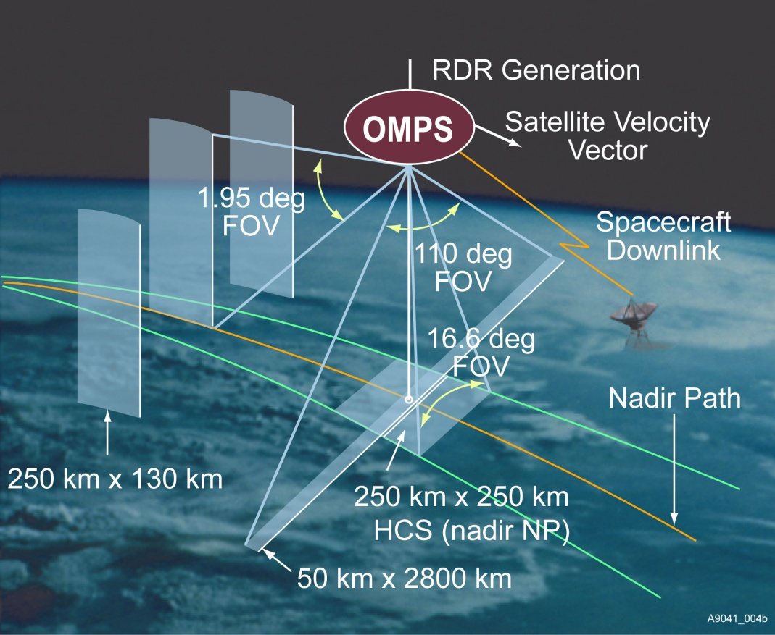
Instrument Fields of View. Schematic from Ball Aerospace and Technology Corporation.

Slide 8
Nadir Mapper & Profiler
The instruments measure radiance scattered from the Earth’s atmosphere and surface. They also make solar measurements using pairs of diffusers. Judicious operation of working and reference diffusers allows analysts to track the diffuser degradation. The solar measurements also provide checks on the wavelength scale and bandpass. The instruments have completed multiple passes through their internal dark and nonlinearity calibration sequences and are beginning to make regular solar measurements. (See information on the OMPS SDRs.)
Main
Electronics
Limb
Profiler
Diagram from Ball Aerospace and Technology Corporation
Entrance Aperture
Entrance Aperture
Earth
Mode
Solar
Mode
Diffuser
Each instrument can view the Earth or either of two solar diffusers; a working and a reference.
Notes:
The OMPS instruments (Nadir Mapper, Nadir Profiler, and Limb Profiler) are designed to take a set of measurements to allow analysts to maintain the instrument characterization and calibration.[2] For each of the instruments, this task can be broken into two components, tracking the performance of the CCD array detectors and electronics, and tracking the performance of the optical components, that is, the telescopes and spectrometers. The instruments make measurements on the night side of orbits with the apertures closed. One set is made without any sources and is used to track CCD array dark currents. Another set is made with illumination by an LED and is used to track CCD non-linearity and pixel-to-pixel non-uniformity response. The instruments also make solar measurements using pairs of diffusers. Judicious operation of working and reference diffusers allows analysts to track the diffuser degradation. The solar measurements also provide checks on the wavelength scale and bandpass. The instruments have completed multiple passes through their internal dark and nonlinearity calibration sequences and are beginning to make regular solar measurements.

Slide 9
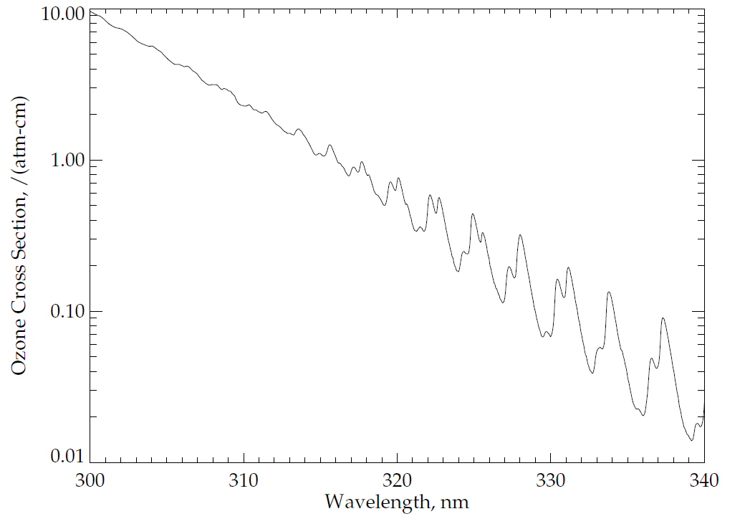
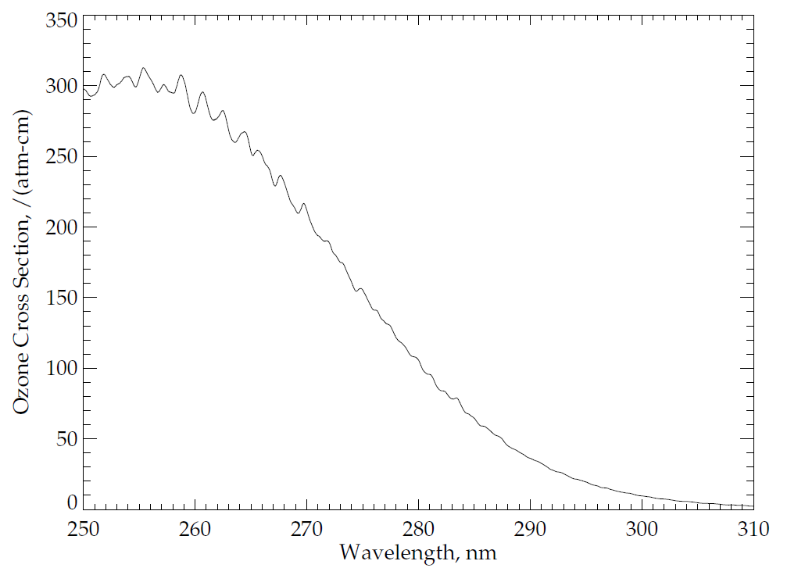
Ozone Absorption Cross Sections:
Ozone has four main absorption bands in the ultraviolet, visible and near-infrared as follows: the Hartley bands from 200 nm to 310 nm, the Huggins bands from 310 nm to 380 nm, the Chappuis bands from 400 nm to 650 nm, and the Wulf bands from 600 nm to 1100 nm. The OMPS nadir telescope directs photons to two spectrometers, one with a wide, cross-track field-of-view (FOV) and spectral coverage in the Huggins ozone absorption bands, and the other with a smaller, nadir FOV and spectral coverage in the Hartley ozone absorption bands. Figures (a) and (b) show the ozone absorption cross-sections at a nominal atmospheric temperature for parts of these bands. These cross-sections are for -50ºC as estimated from a quadratic fit in temperature of the Brion-Daumont-Malicet data set.
(a)
Patterns in Ozone
Absorption
(b)
Dramatic Increase in Ozone
Absorption
Notes:
See J. Malicet, D. Daumont, J. Charbonnier, C. Parisse, A. Chakir, and J. Brion, "Ozone UV spectroscopy. II. Absorption cross-sections and temperature dependence," J. Atmos. Chem. 21, 263-273 (1995) and references therein.
Quadratic fit provided by D. Haffner.
Figure by L. Flynn.

Slide 10
OMPS Nadir Mapper Spectra
The plot at the top of the following slide shows a sample OMPS Nadir Mapper solar spectrum measured in January. The initial calibration, goniometry and wavelengths scales have been applied. Notice the Fraunhofer lines, e.g., a deep one near 360 nm.
The plot in the middle shows a sample spectrum for the Earth View data for the nadir field-of view.
The plot on the bottom shows the ratio of the first two spectra. Notice that much of the structure in the solar spectrum cancels out in the ratio. Also notice the variations between 320 nm and 330 nm produced by differential ozone absorption with wavelength as illustrated in the Figure (a) from two slides earlier.

Slide 11
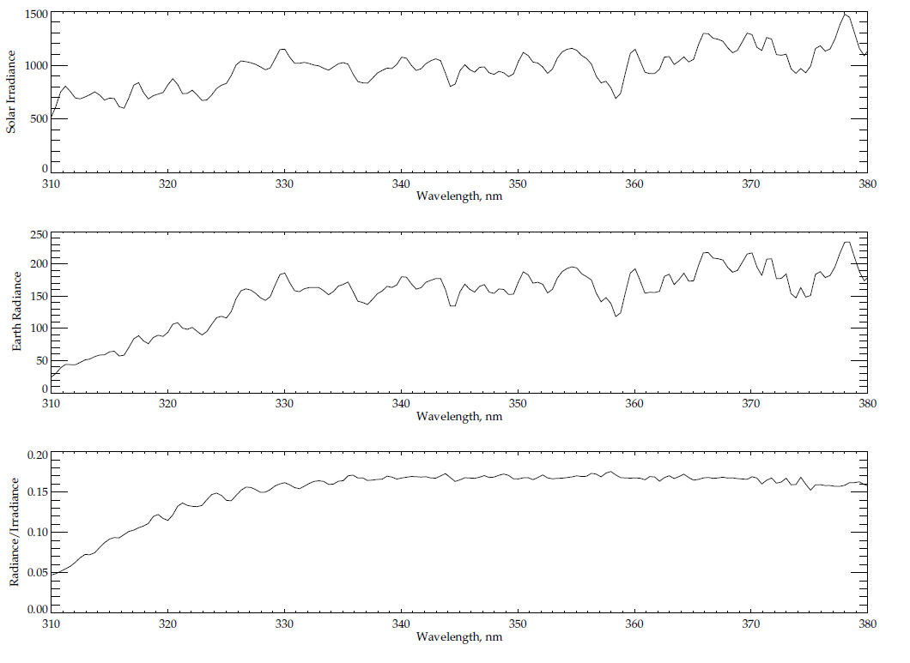
Typical spectra from 310 to 380 nm for OMPS Nadir Mapper
Solar Line
Solar Irradiance
Earth Radiance
Ozone Absorption Features
Radiance/Irradiance Ratio
310
380
Wavelength, nm

Slide 12
OMPS Nadir Profiler Spectra
The plot at the top of the following slide shows a synthetic OMPS Nadir Profiler solar spectrum measured currently in use. The spectrum was created by combining the laboratory bandpass characterization with a high spectral resolution reference solar spectrum. Notice the Fraunhofer lines, e.g., a deep Mg one near 280 nm.
The plot in the middle shows a sample spectrum for the Earth View data. The initial calibration, goniometry and wavelengths scales have been applied.
The plot on the bottom shows the ratio of the first two spectra. Notice that much of the structure in the solar spectrum cancels out in the ratio. Also notice the rapid drop in albedo from 310 nm to 290 nm produced by differential ozone absorption with wavelength as illustrated in the Figure (b) from four slides earlier.

Slide 13
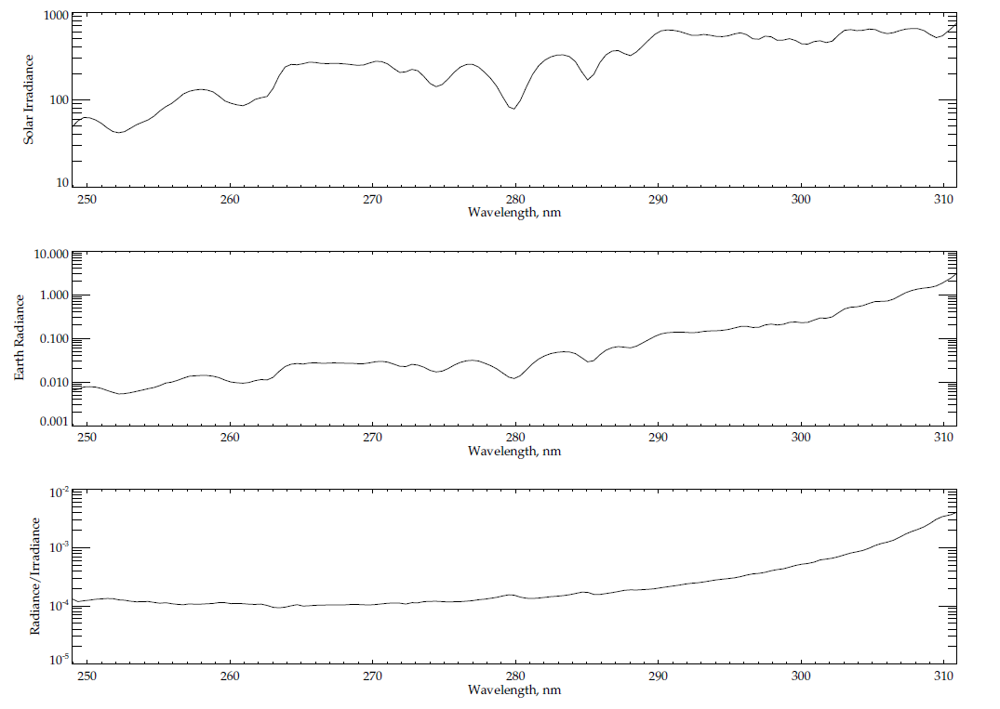
Typical spectra from 250 to 310 nm for OMPS Nadir Profiler
Solar Lines
Solar Irradiance
Earth Radiance
Radiance/Irradiance Ratio
Relative Ozone Absorption Effects
250
310
Wavelength, nm

Slide 14
Caveats for OMPS NP Earth-View SDR
Dark current for OMPS NP were not updated between February 29, 2012 and February 14, 2013. This can result in positive SDR bias (higher than truth) that generally increases with time and decreases with wavelength. As of the end of 2012, the bias can be up to 1% for wavelength shorter than 255 nm but about 0.1% for wavelength longer than 285 nm. Darks are currently updated weekly.
The OMPS NM and NP dark will be updated weekly for most part of the Provisional products, which is less frequent than originally designed. This can result in small but systematic positive bias (higher than truth) in SDR. For NM, the bias is negligible for most wavelength. In rare cases where signals are extreme weak, such as near the terminator and for wavelength shorter than 305 nm, the bias can reach 0.2%. For NP, the bias generally decreases with wavelength, up to 0.02% for wavelength shorter than 255 nm and down to 0.002% for wavelength longer than 285 nm.
The spectral solar irradiances have been updated with on-orbit measurements for both NM and NP. Further analysis and update of Day One solar irradiance may be provided in future. These preliminary and additional updates of Day One solar have been planned before launch as part of normal calibration update.
The wavelength scales for the OMPS NM and NP for both Earth and solar spectra have been updated with on-orbit measurements. The adjustments were somewhat larger than expected from pre-launch thermal analysis. We will monitor and re-evaluate periodically.
While the OMPS NP South Atlantic Anomaly (SAA) flag is working well in identifying regions with higher frequency of charged particles, we plan to improve the OMPS SDR performance over SAA as more results become available and are analyzed.
The OMPS NP measurements are affected by out-of-band stray light. We are comparing the size and source of these contributions in-orbit to the ground-based measurements and developing a correction.

Slide 15
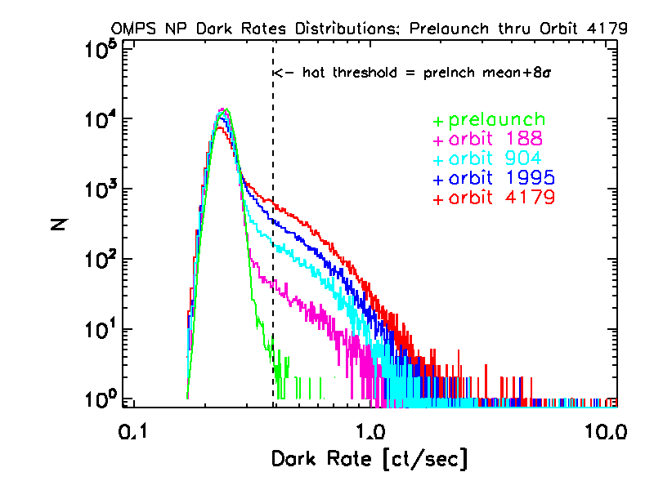
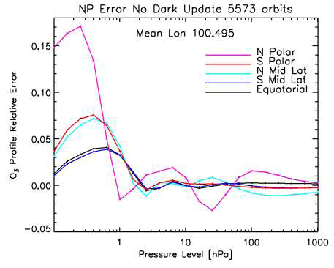
Effect of 40 weeks of no dark updates on ozone profile retrievals
Cuts from surface plot NP orbit 5573 fractional error in as a function of altitude in 5 latitude bins: Polar: >60 deg, Equatorial: < 12.5 deg, Mid: > 35 < 45 deg.
Dark Current Monitoring and Correction for OMPS
Michael Haken and Glen Jaross
NASA-GSFC/SSAI
Notes:
Dark Current Monitoring and Correction for OMPS
Michael Haken and Glen Jaross
NASA-GSFC/SSAI

Slide 16
IMOPO Known Product Deficiencies
  Profile and total ozone error flags are switched in the output. (Parent PCR 27740 – Expected correction early 2013 with Mx7.0)
Snow/Ice data is all zeroes (DR #4802)
The input-out-of-bound flag (Error Code 20) is set with an incorrect check on surface pressure (DR #4860, CCR 595 Corrected in Mx6.6 2/28/2013). 20% or more of the data was improperly flagged prior to this change.
Stray Light^
  Correction subroutine and definitive estimates of coefficients are under development (DR #4823).
Radiance Coefficients^
  Adjustments could be entered through CF Earth (DR #5047).
Dark Tables’ weekly updates began in 2/2013 (DRs #4749, #4818)
The 252 nm channel is currently not used in the retrieval (DR #7013)
Wavelength Scale and Solar^
  Working on definitive Day 1 and time dependence
  Working on adjustments for intra-orbit scale drift
^ These may create large discontinuities in the product performance as they and similar changes enter the system.
Notes:
DR – Discrepancy Report
CCR – Configuration Control Request
Draft Timeline of major changes in OMPS Nadir Products
• Problem with wavelength scale in NM February
• Problem with wavelength scale in NP February (DOY error) Final data at CLASS? No.
• May 7, 2012 – New OMPS NM and OMPS NP Wavelength Scales CCR #389
• June 11, 2012 – New OMPS NM Day 1 Solar Irradiance CCR #411
• July 17, 2012 – OMPS NP Day 1 Solar Irradiance CCR #458
• August 10, 2012 – New NM RT LUT CCR #343 (Mx6.1)
• August 10, 2012 – CTP to UV for INCTO CCR #385 (Mx6.2)
• October 15, 2012 – OMPS NM E/S distance CCR #481 (Mx6.3)
• October 15, 2012 – Partial cloud and VIIRS CF CCR #419 (Mx6.3)
• TLE in use for Ephemeris Mx6.3 – Mx6.4
• Updates to VIIRS Snow/Ice Tiles xxx
Future
• February 2013 – IMOPO Surface Pressure limit too restrictive CCR #595 (Mx6.6)
• April 2013 – CTP for OOTCO CCR #736 (Mx7.0)
• April 2013 – Profile and TOZ flags switched in IMOPO PCR (Mx7.0)

Slide 17
Timeline of major changes in OMPS Nadir Products
Problem with wavelength scale in NM February 2012
Problem with wavelength scale in NP February 2012 (DOY error) Final data at not at CLASS
May 7, 2012 – New OMPS NM and OMPS NP Wavelength Scales CCR #389
June 11, 2012 – New OMPS NM Day 1 Solar Irradiance CCR #411
July 17, 2012 – OMPS NP Day 1 Solar Irradiance CCR #458
August 10, 2012 – New NM RT LUT CCR #343 (Mx6.1)
August 10, 2012 – CTP to UV for INCTO CCR #385 (Mx6.2)
August 10, 2012 – Four corner GEO fix for GONPO
October 15, 2012 – OMPS NM E/S distance CCR #481 (Mx6.3)
October 15, 2012 – Partial cloud and VIIRS CF CCR #419 (Mx6.3)
TLE in use for Ephemeris Mx6.3 – Mx6.4
Updates to VIIRS Snow/Ice Monthly Tiles
February 2013 – IMOPO Surface Pressure limit too restrictive CCR #595
Future
April 2013 – NP Dark tables need to be updated in the SAA DR #7054
June 2013 – CTP for OOTCO CCR #736 (Mx7.0)
June 2013 – Profile and TOZ flags switched in IMOPO PCR (Mx7.0)

Slide 18
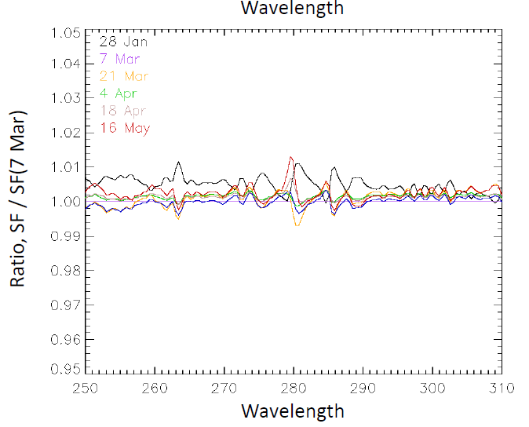
OMPS NP Solar Flux Measurements
Comparison of the first six solar measurements from the working diffuser.
The lines give the ratios of the five other measurements to the March 7th one. The instrument / diffuser throughput shows little change over the four months, especially as there should be some differences due to real solar spectrum changes. Possible additional sources (e.g., goniometric characterization, minor wavelength scale drift, and dark current evolution) are under investigation.
A future reference solar diffuser measurement will add more information.
Wavelength, nm
From C. Seftor, SSAI
Notes:
From C. Seftor

Slide 19
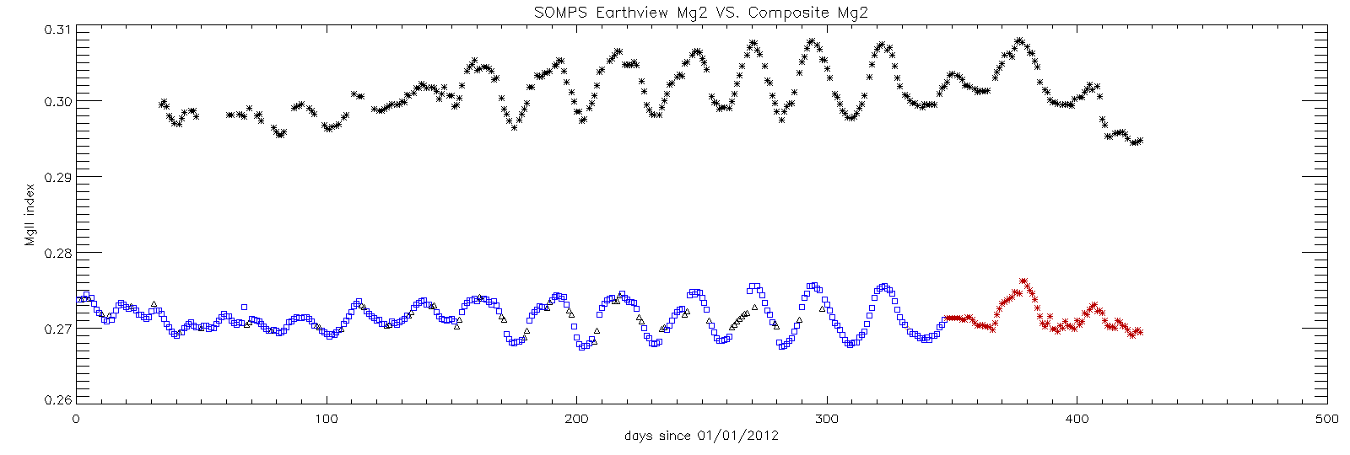
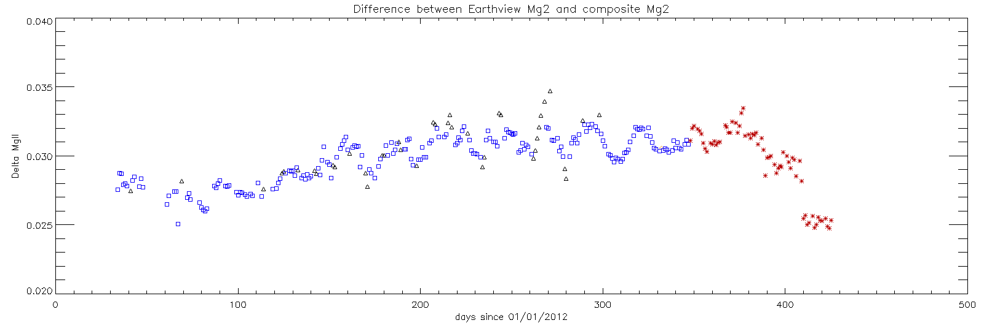
Mg II Index Comparison
Comparison of a composite Mg II Index (core to wing ratio near 280 nm) solar measurements (lower curve on upper plot) to an Earth view MG Index estimate from OMPS NP spectra (upper curve on upper plot). The lower figure show the differences. The break near the end occurs when new dark current corrections are introduced for the OMPS NP for the first time in a year. The Earth-view index will be used with scale factors to track daily solar changes for the shorter NP wavelengths.
http://www.spacewx.com/About_MgII.html
Notes:
http://www.spacewx.com/About_MgII.html

Slide 20
Ozone Profile Product, IMOPO
The spectral measurements from the OMPS Nadir Profiler and Nadir Mapper of the radiances scattered by the Earth’s atmosphere are used to generate estimates of the ozone vertical profile along the orbital track (IMOPO). The algorithm uses ratios of Earth radiance to Solar irradiance at a set of 12 wavelengths (at approximately 253, 273, 283, 288, 292, 298, 302, 306, 313, 318, 331 and 340 nm) with eight from the Nadir Profiler and four from the Nadir Mapper to obtain estimates of the total column ozone, effective reflectivity, and the ozone vertical profile in 12 Umkehr Layers. The radiances for the four longer wavelength are obtained from the 25 Nadir Mapper FOVs co-located with a single Nadir Profiler FOV. The longer channel radiance/irradiance ratios are used to generate estimates of the total column ozone and scene effective reflectivity. The total column ozone is used to generate a first guess ozone profile that becomes the A Priori for a maximum likelihood ozone profile retrieval using the ratios for the seven shortest wavelengths (omitting the 253 nm channel and including 313 nm at high SZA). Additional information is in the OMPS Nadir Profile Algorithm Theoretical Basis and Operational Algorithm Description Documents, and a volume of the Common Data Format Control Book at: http://npp.gsfc.nasa.gov/documents.html
OMPS NP ATBD 474-00026_Rev-Baseline.pdf
OMPS NP OAD 474-00067_OAD-OMPS-NP-IP-SW_RevA_201
Intermediate Product CDFCB
474-00001-04-01_CDFCB-Vol4-Part1_Rev-_Block-1-1_31Mar2011.pdf20127.pdf

Slide 21
Matching the FOVs for the Nadir Mapper and Nadir Profiler
The Nadir Mapper and Nadir Profiler each produce data in 37.5-second granules. The Nadir Profiler IFOV is designed to coincide with the five central IFOVs of the Nadir Mapper, and a single measurement of the Nadir Profiler aggregated over 37.5 S matches up with five Nadir Mapper rows each aggregated for 7.5 S. The two instruments may begin their granules at different times relative to the southern terminator crossing offset by multiples of 7.5 S.
The Figures on the next slide show the results of an investigation into the alignment of Nadir Mapper and Nadir Profiler granules in their respective geolocation products, GOTCO and GONPO. The first three plots (top left, bottom left, and top right) each display the FOV center locations of three consecutive granules for both the Nadir Mapper and the Nadir Profiler. Each set of 25 small symbols show the location for the five nadir cross track FOVs (nadir and two nearest on both sides) for the five rows of measurements in a granule. The large symbols are the FOV center locations for the Nadir Profiler. Notice that the Nadir Profiler may matchup with a Nadir Profiler granule or it may be offset by one or two rows.
The figure on the bottom right shows an unusual case where there is a Nadir Mapper granule that only contains four rows – 30 S of measurements instead of 37.5 S. This can lead to changes in the offset between the granules for the Nadir Mapper and Nadir Profiler within an orbit. The IMOPO products follow the Nadir Profiler granularity.

Slide 22
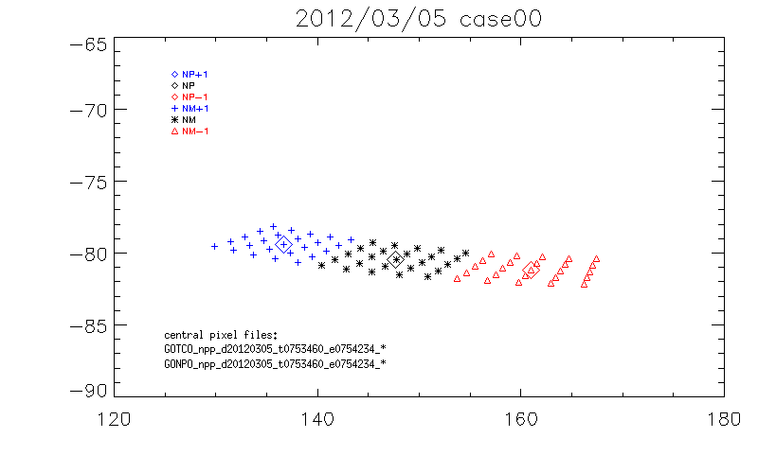
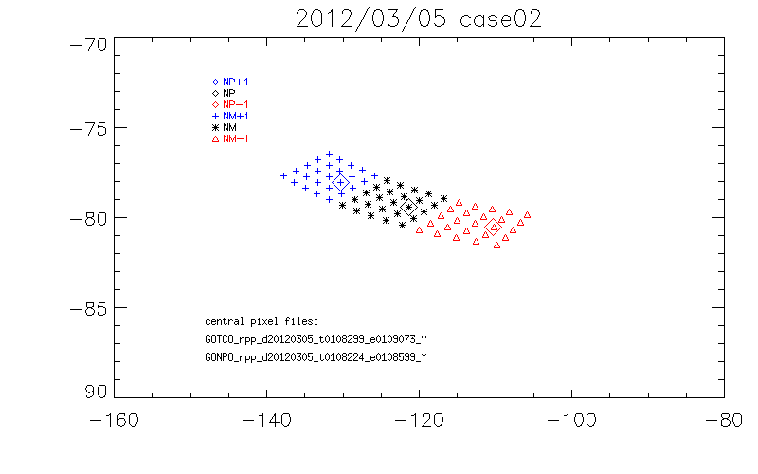
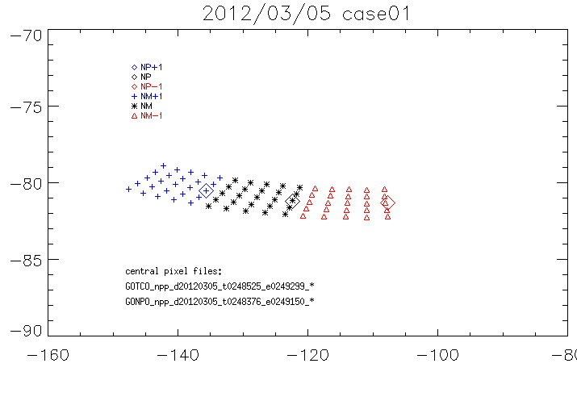
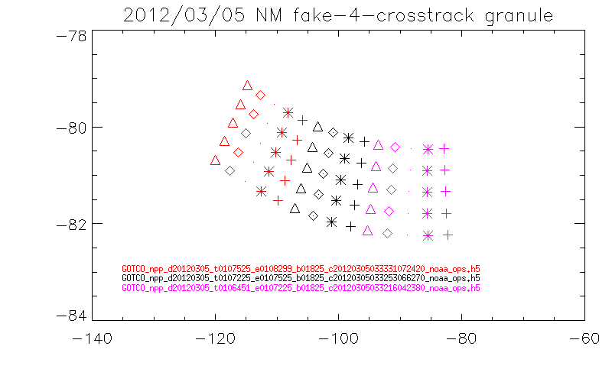
Figs. From J. Niu, ERT
Longitude & Latitude Locations for GOTCO and GONPO Granule Matching Cases
Longitude, Degrees East
Longitude, Degrees East
Longitude, Degrees East
Longitude, Degrees East
Notes:
Figs. From J. Niu, ERT

Slide 23
IMOPO Error Flags
Individual Flags
  Sun Glint, SAA, and Eclipse are all set correctly
  SO2 Index is running too negative; it and the Volcano Contamination Index (VMI) are affected by initial calibration uncertainties.
  Snow/Ice is always zero – DR #4802
Profile Error Codes*
  Code 1 is set correctly (Lower three layers)
  Code 2 is set correctly (BestTOZ vs ProTOZ)
  Code 3 is set correctly (large final residuals – often for data in SAA)
  Code 5 is set correctly (C outside of range – often for data in SAA)
  Codes 4, 6, 7 & 8 conditions are not met in samples
  Code 9 (Bad counts/missing measurements)
  Code 20 Invalid or out-of-range inputs – Flagged all terrain pressure > 1.001 atm until fixed in February 2013.
  Descending Flag (+10) set incorrectly – A simple check of latitude changes will work.
Total Ozone Error Codes*
  Codes 1 & 2 are set correctly by comparing S x Omega to 1.5 and 3.5 atm-cm, respectively
  Code 4 is set correctly (Pair differences)
  TOZ Error Code 5 matches PRO Code 2
  Code 7 not seen; Photometer Reflectivity difference is not in the output.
  Codes 8 & 9 conditions are not met in samples; Codes 3 & 6 are Spares
  Code 20 Invalid or out-of-range inputs – matches profile behavior
  Descending Flag (+10) matches Profile Error behavior
  *Profile and total ozone error flags are switched in the HDF5 output. This should be repaired with the implementation of PCR 27740 in Mx7.0 in Early 2013.
Notes:
For total ozone code 7, the subroutine BESTOZ.F has 0.15; the OAD has 0.05 – although ecode is used as a name for both error codes and the OAD has 0.15 for the profile Code 7.
Is 252 nm channel turned off? Yes. Check IOPTS for NO_2520_RAD_INDEX = 8 in NP_CONSTANTS.F

Slide 24
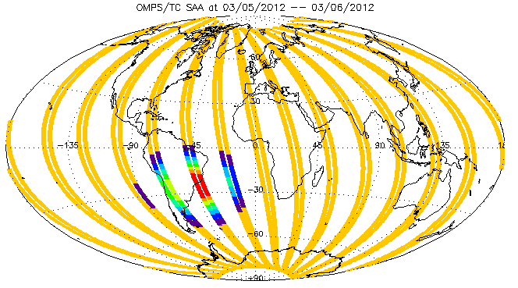
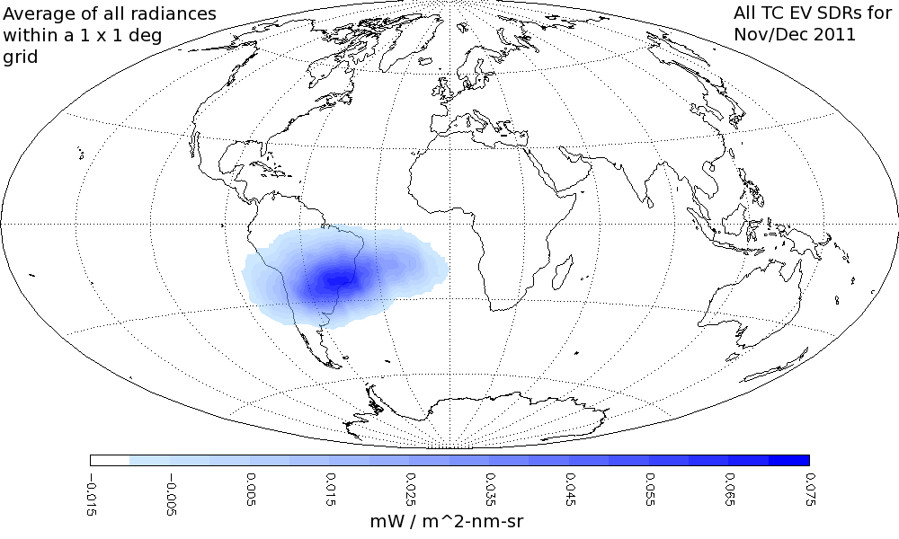
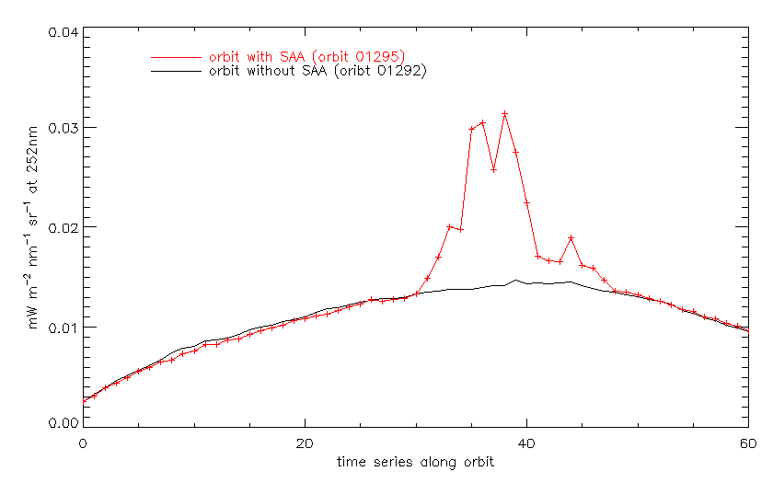
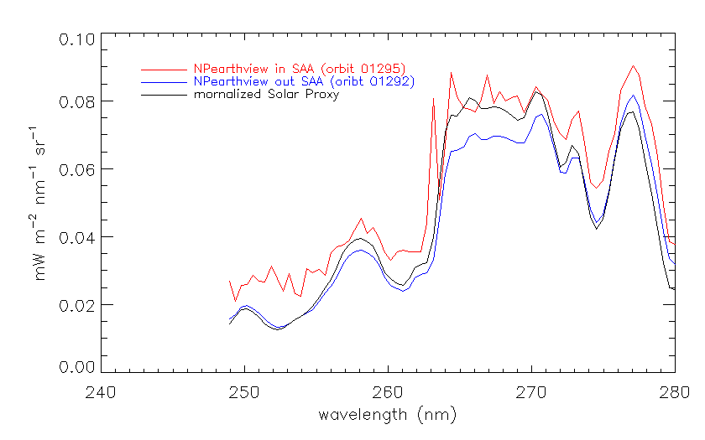
Examination of South Atlantic Anomaly (SAA) effects and product flagging.
The noise/spikes below show the expected increases when an orbital path falls with within the SAA but return to normal levels after passing through it.
The OMPS was designed to use the OMPS Limb Profiler retrievals in the SAA where the OMPS Nadir Profiler is so greatly affected by charged particles that it cannot be used to produce ozone profiles.
Radiance map C. Seftor, SSAI,
Flag map Y. Hao, IMSG
Radiance Line Plots J. Niu, ERT
Map of South Atlantic Anomaly effects on OMPS NM closed-door dark current measurements in December and November 2011, overlaid with OMPS NP SAA Flags (0 to 8) for 3/5-6/2012
Wavelength, nm
Notes:
Radiance map C. Seftor, SSAI, Flag map Y. Hao, IMSG
Radiance Line Plots J. Niu, ERT

Slide 25
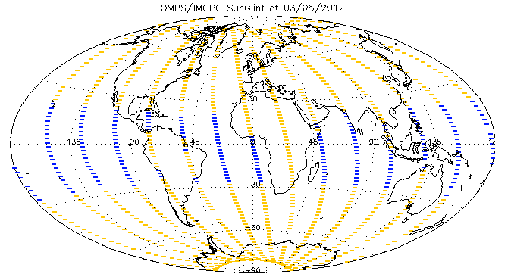
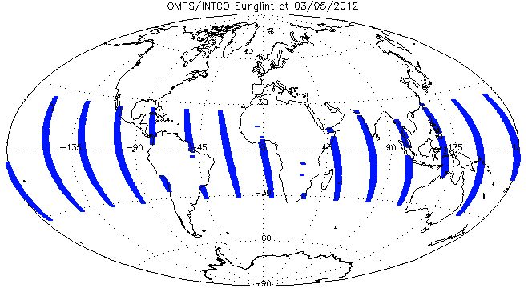
Daily Maps of Sun Glint for INCTO Nadir FOVs versus IMOPO. The two products are consistently and correctly passing these values through from the SDRs.
Figs. From Y. Hao, IMSG
Notes:
Figs. From Y. Hao

Slide 26
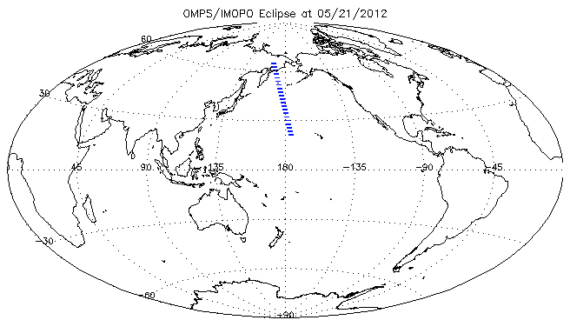
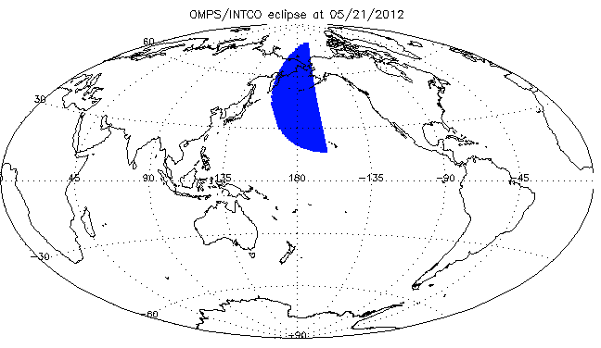
← Map showing locations of IMOPO Eclipse Flags for May 21, 2012.
The two products are giving correct and consistent results for the near nadir FOVS.
Location of Eclipse Flags for OMPS Nadir Mapper First Guess Total Column Ozone INCTO Product for May 21, 2012. →
Figs. From Y. Hao, IMSG
Notes:
Eclipse flag figures from Y. Hao.

Slide 27
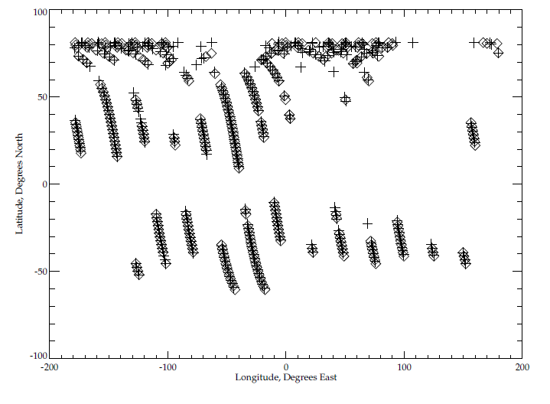
Map of Error Code 20 for IMOPO and of
Terrain Pressure > 1.001 atm. for INCTO
This map shows the location of two sets of conditions. One is the location of Error Code 20 (inputs out of range) for IMOPO for May 16, 2012. The diamond symbols show the locations of these FOVs. The others are the locations where the Nadir Mapper INCTO total column ozone product reports values of terrain pressure greater than 1.001 atm. for the same day. The plus sign symbols are placed where the terrain pressure for the nadir FOV (cross track position 17) for the first row (of five rows) of a Nadir Mapper Granule satisfies this condition. Almost all of the Error Code 20 values are set because of this condition. The check is too restrictive and needs to be reset to a larger value. The highest pressure recorded on Earth was 1.071 atm. The Dead Sea is at ~1.045 atm.
Latitude, Degrees North
This error has been fixed as of 2/28/2013
Longitude, Degrees East

Slide 28
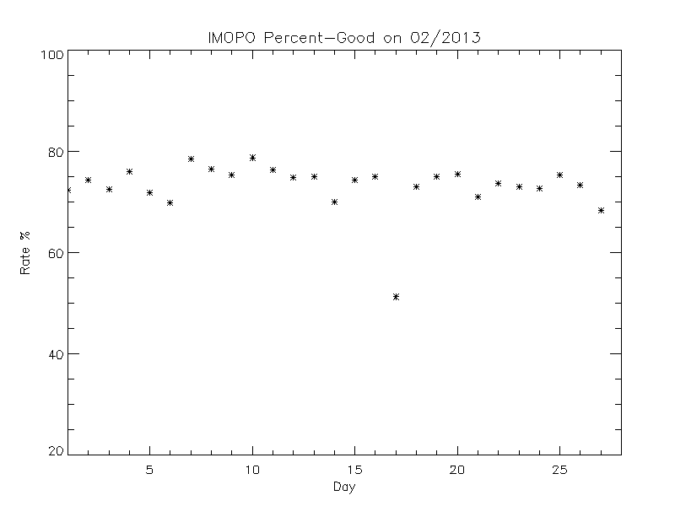
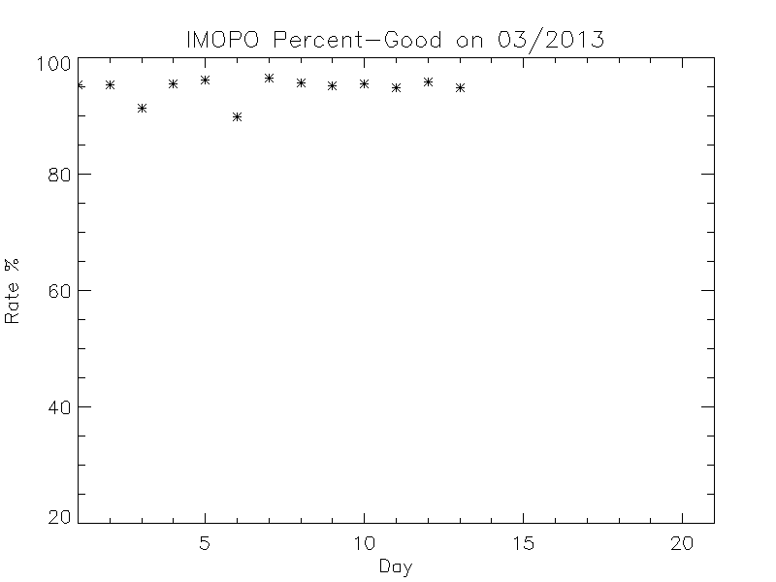
Time series of Daily Global Percent Good for IMOPO
The figure to the left shows the product quality (percent good) for February 2013 – prior to the surface pressure bound correction.
The figure to the right shows the product quality (percent good) for the first two weeks of March 2013 – after the surface pressure bound correction.
http://www.star.nesdis.noaa.gov/icvs/PROD/proOMPSbeta.O3PRO_IMOPO.php
Notes:
http://www.star.nesdis.noaa.gov/icvs/PROD/proOMPSbeta.O3PRO_IMOPO.php

Slide 29
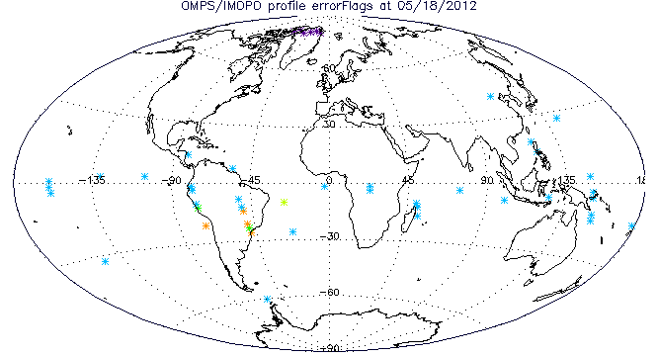
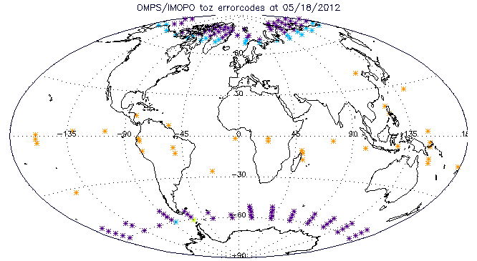
These maps show the distribution of non-zero (except for 20s) error codes for IMOPO May 18, 2012.
The top map shows the locations for the ozone profile errors (actual not as misnamed in the HDF). The colors (and frequencies) are as follows: 1 Lower Layer Anomaly (6); 2 Best Total Ozone difference with Profile Total Ozone (34); 3 Large Final Residual (2); 4 Large Initial Residual (1); and 5 C-Parameter Outside of Range (4).
The bottom map shows the locations for the total ozone errors (again actual). The colors are as follows: 1 High Path (100); 2 Very High Path (23); 4 Pair Total Ozone Difference (1); and 5 same as Profile Code 2 (33).
Figs. From Y. Hao, IMSG
Notes:
Figure from Y. Hao.

Slide 30
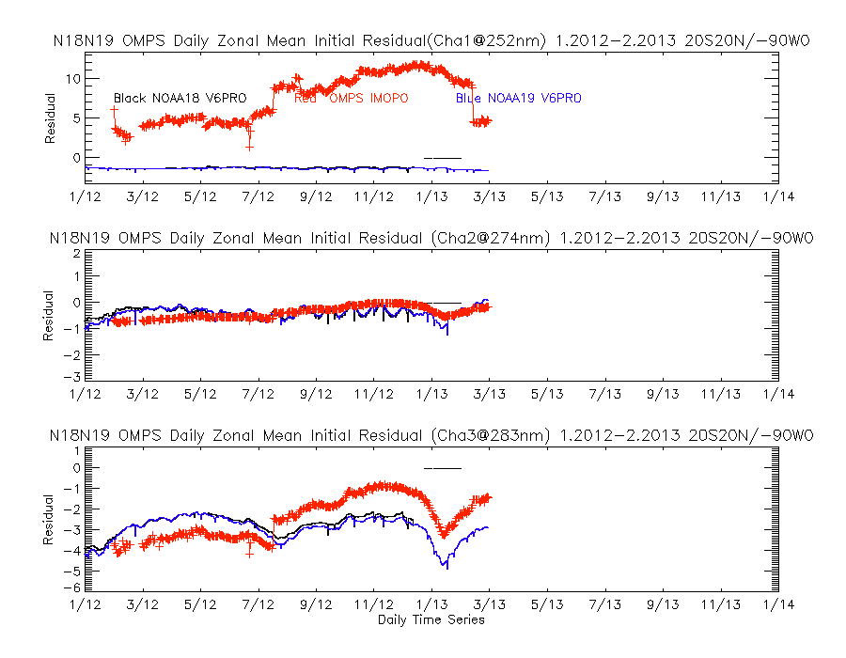
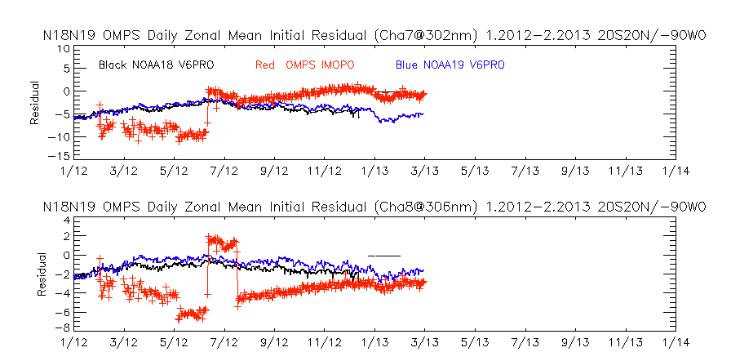
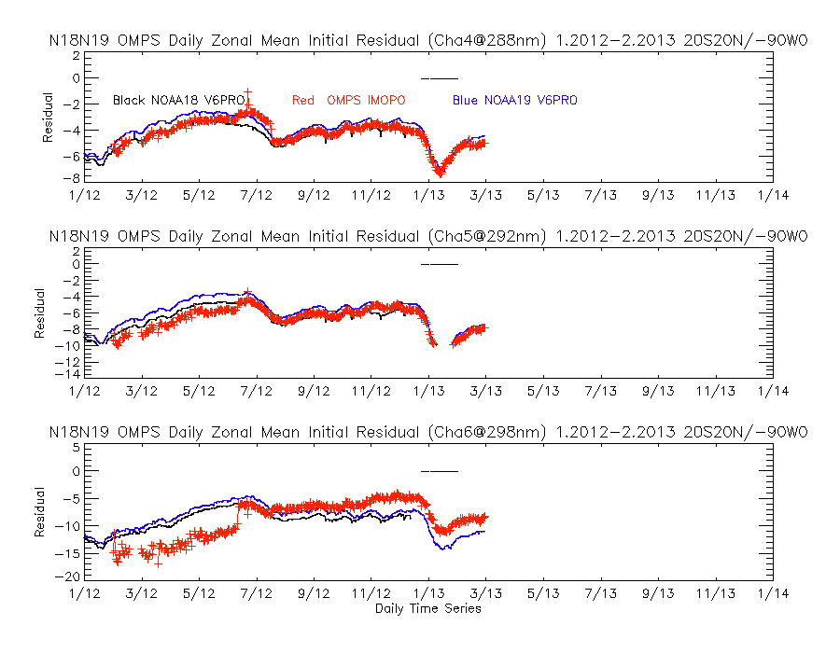
Time series of initial V6PRO residuals for OMPS NP for 2012
(a)
(g)
(b)
(h)
The eight figures show the initial residuals for profile wavelengths [252, 274, 283, 288, 292, 298, 302, 306 and, (a) to (h), respectively] for the V6PRO (IMOPO) product from OMPS compared to the V6PRO product for the operational NOAA-18 and NOAA-19 SBUV/2 for the equatorial daily zonal means (20N to 20S) with 0-90W removed to avoid the SAA effects. The residuals are in N-values (1 N ~ 2.3%). The time period is the end of February 2012 through February of 2013. The residuals are computed with respect to differing first guess profiles especially with respect to the use of the shortest channel. The jump in the initial residuals in early June is coincident with the introduction of a new Day 1 Solar Spectrum for the Nadir Mapper. The jump in March 2013 is coincident with the introduction of new dark corrections.
(c)
(d)
(e)
(f)
www.star.nesdis.noaa.gov/icvs/PROD/proOMPSbeta.O3PRO_IMOPO.php
W. Yu, ERT.
Notes:
Figs. From

Slide 31
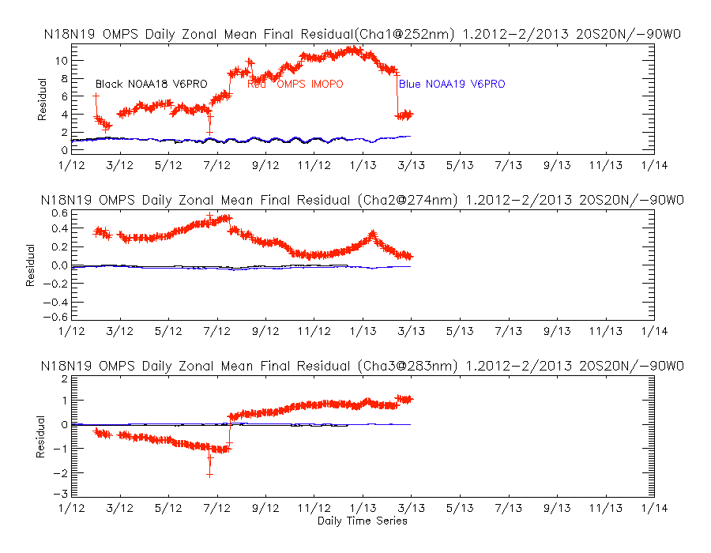
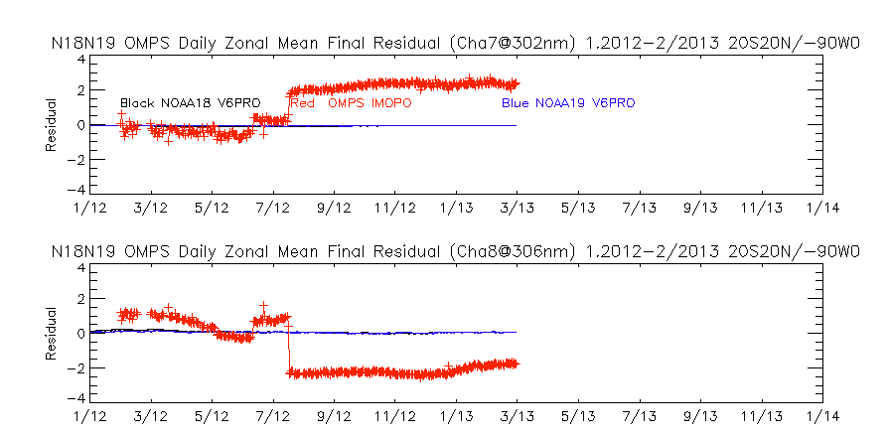
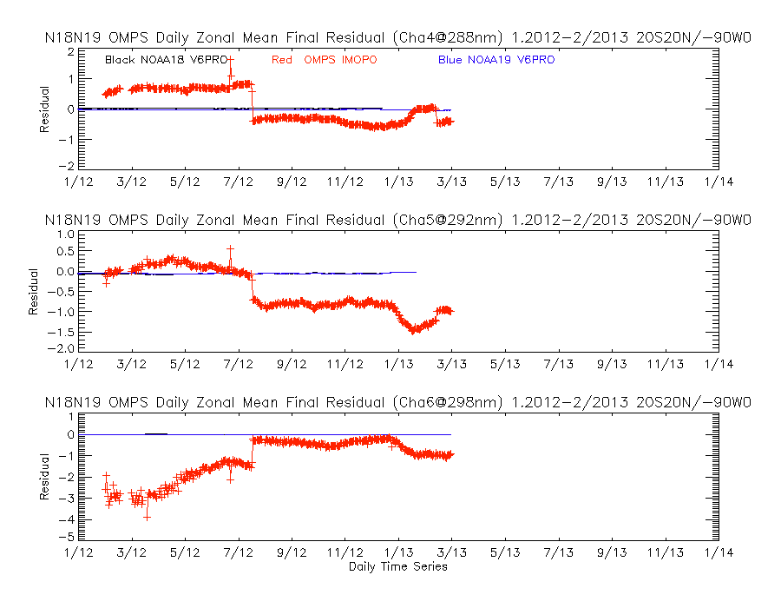
Time series of final V6PRO residuals for OMPS NP for 2012
(a)
(g)
(b)
(h)
(c)
The eight figures show the final residuals for profile wavelengths [252, 274, 283, 288, 292, 298, 302, 306 and, (a) to (h), respectively] for the V6PRO (IMOPO) product from OMPS compared to the V6PRO product for the operational NOAA-18 and NOAA-19 SBUV/2 for the equatorial daily zonal means (20N to 20S) with 0-90W removed to avoid the SAA effects. The residuals are in N-values (1 N ~ 2.3%). The time period is the end of February 2012 through February 2013. The residuals are computed with respect to differing first guess profiles especially with respect to the use of the shortest channel. The jump in the initial residuals in early June is coincident with the introduction of a new Day 1 Solar Spectrum for the Nadir Mapper.
(d)
(e)
(f)
www.star.nesdis.noaa.gov/icvs/PROD/proOMPSbeta.O3PRO_IMOPO.php
W. Yu, ERT.
Notes:
Figs. From

Slide 32
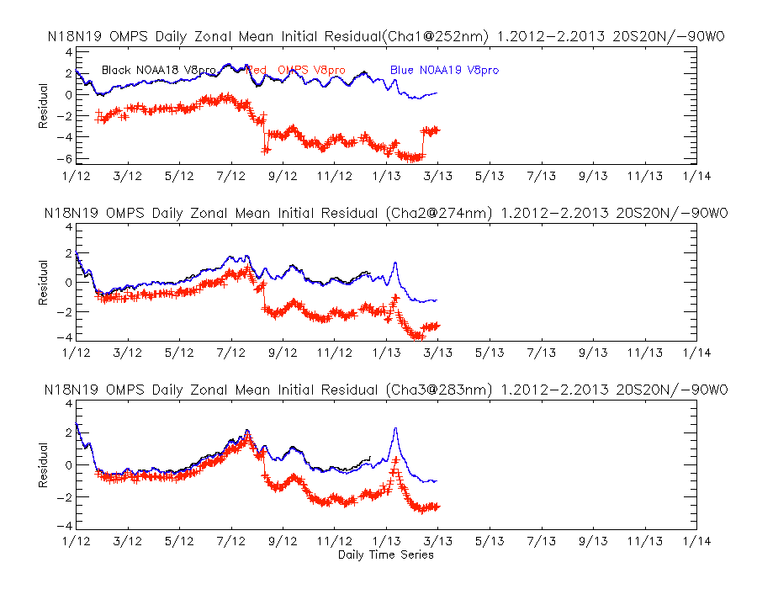
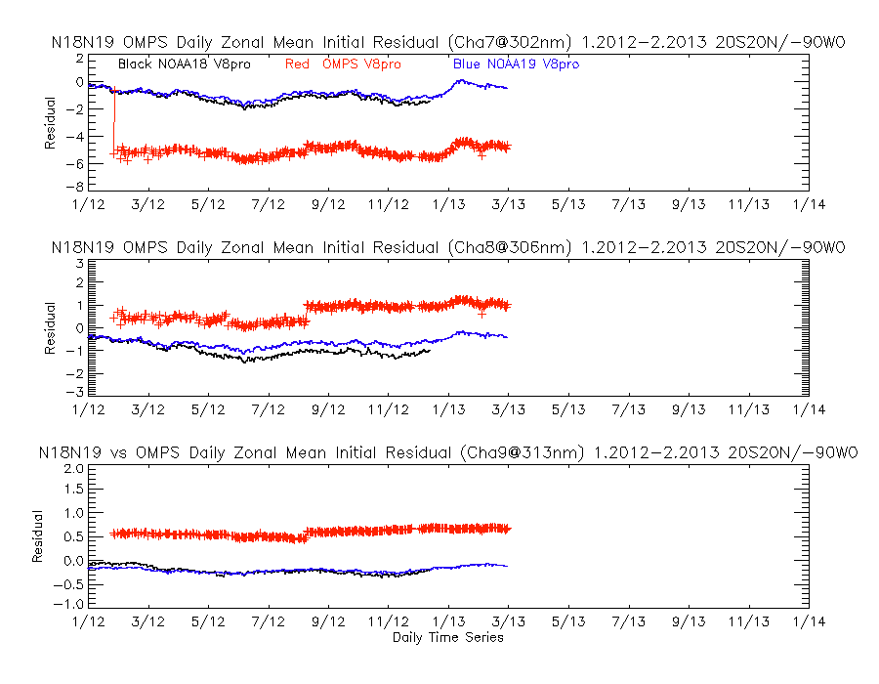
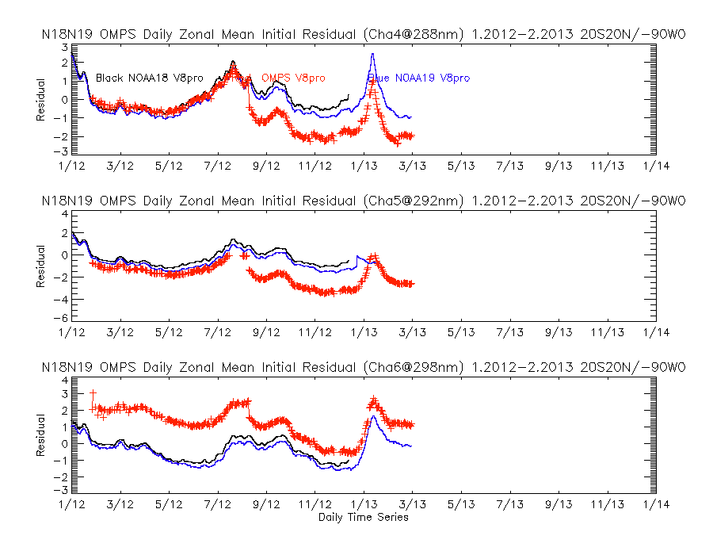
Time series of initial V8PRO residuals for OMPS NP February through December
(a)
(g)
(b)
(h)
(c)
(i)
The nine figures show the initial measurement residuals for profile wavelengths [252, 274, 283, 288, 292, 298, 302, 306 and 313 nm, (a) to (i) in order, respectively] for the V8PRO product from OMPS compared to the same product for the operational NOAA-18 and NOAA-19 SBUV/2 for the equatorial daily zonal means (20N to 20S) with 0-90W removed to avoid the South Atlantic Anomaly. The residuals are in N-values (1 N ~ 2.3%). The time period is 2012(Feb to Dec for OMPS). Notice that the shorter wavelengths’ residuals for OMPS, have maintained their offsets allowing for the large shifts taking place in August when the new solar came into use with the OMPS V8Pro, and February when new darks were implemented.
(d)
(e)
(f)
www.star.nesdis.noaa.gov/icvs/PROD/proOMPSbeta.O3PRO_V8.php
W. Yu, ERT.
Notes:
http://www.star.nesdis.noaa.gov/icvs/PROD/proOMPSbeta.O3PRO_V8.php
W. Yu, ERT.

Slide 33
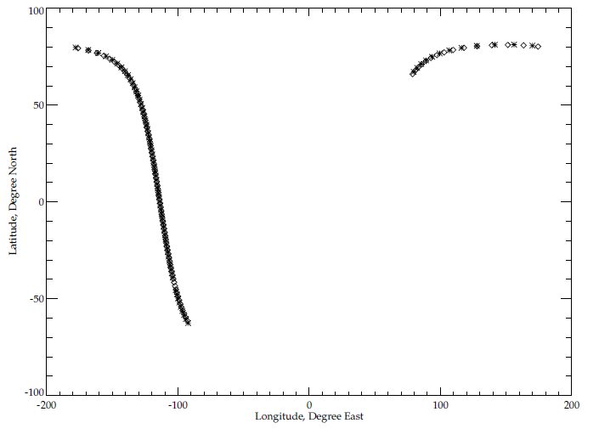
Well-matched Orbits for May 16, 2012
Map of location for sample formation orbit. The NOAA-19 POES is in a similar orbit as the S-NPP spacecraft (sun-synchronous polar orbit with close to 1:30 PM local time ascending node equator crossing). Approximately every 12 days the two satellites’ orbits align very well in both space and time. The figure to the left shows the measurements locations for a pair of orbits on May 16, 2012 the asterisks are S-NPP OMPS NP FOV locations and the diamonds are NOAA-19 SBUV/2 FOV locations.
Given the large fields-of-view of the two instruments, these matchup orbits provide a good source of comparisons. The near coincidences are exploited in the results presented in the next sets of figures.
Latitude, Degrees North
Longitude, Degrees East

Slide 34
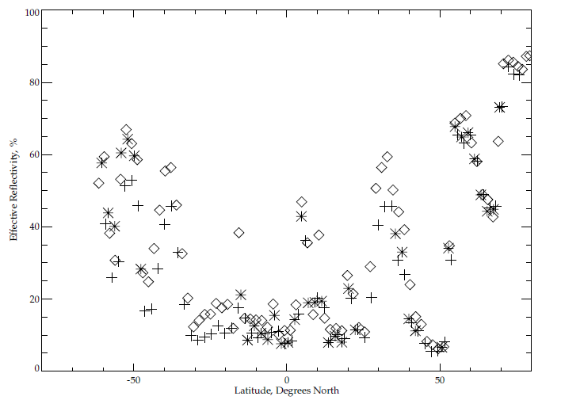
Reflectivity Comparisons to INCTO & SBUV/2
Comparisons of effective reflectivity estimates between IMOPO and the OMPS total ozone first guess product (INCTO) and between IMOPO and the NOAA-19 SBUV/2 processed with the Version 6 ozone profile retrieval algorithm. The data are from a single pair of orbits on May 16, 2012 where the two satellites are flying in formation (orbital tracks within 50 KM and sensing times with 10 minutes). The OMPS Nadir Profiler values are shown with asterisks (*), the OMPS Nadir Mapper values are shown with plus signs (+) and the SBUV/2 are shown with diamonds (<>). A significant number of the OMPS Nadir Profilers retrievals produce fill values because of Error Codes incorrectly set to 20.
Effective Reflectivity, %
The.
Latitude, Degrees North
Notes:
NOAA-19 POES EQCT ~1:32PM
The INCTO values are the averages of 25 retrievals – five consecutive retrievals for the five nadirmost FOVs.

Slide 35
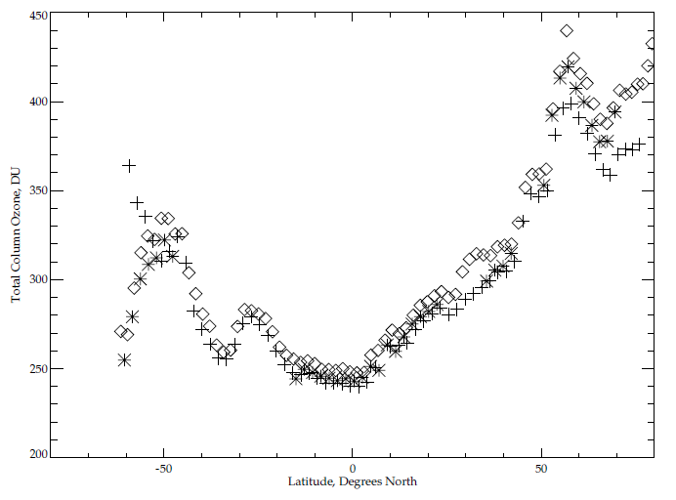
Total Ozone Comparisons to INCTO & SBUV/2
Comparisons of total column ozone estimates between IMOPO and the OMPS total ozone first guess product (INCTO) and between IMOPO and the NOAA-19 SBUV/2 processed with the Version 6 ozone profile retrieval algorithm. The column amounts are the profile totals for the two Version 6 products. The data are from the same pair of orbits on May 16, 2012 used for the previous slide. The OMPS Nadir Profiler values are shown with * (asterisks), the OMPS Nadir Mapper values are shown with + (plus signs) and the SBUV/2 are shown with <> (diamonds). A significant number of the OMPS Nadir Profilers retrievals produce fill values because of Error Codes incorrectly set to 20.
Total Column Ozone, DU
Latitude, Degrees North

Slide 36
Profile Comparisons between OMPS & SBUV/2 V6Pro
The figures on the next three slides show comparisons of the ozone profile retrievals estimates between IMOPO and the NOAA-19 SBUV/2 processed with the Version 6 ozone profile retrieval algorithm. The data for the first two are from another single pair of orbits on May 16, 2012 and for the thirds are from March 8, 2013, where the two satellites are flying in formation (orbital tracks within 50 KM and sensing times with 10 minutes) and
The first and third slides compare the ozone profile retrievals in 12 pressure layers in Dobson Units versus Latitude. The 12 layers are defined by the following 13 layer boundaries:
[0.0,0.247,0.495,0.99,1.98,3.96,7.92,15.8,31.7,63.3,127.0,253.0,1013] hPa.
The top three layers’ results are in the top row with the topmost layer on the upper left. The lowest layer’s results are in the figure on the bottom right. The OMPS Nadir Profiler values are in Pink and the SBUV/2 are shown in Black. A significant number of the OMPS Nadir Profilers contain fill values because of Error Codes incorrectly set to 20.
The second slide shows the results of comparison for the ozone mixing ratios at 19 pressure levels: [0.3,0.4,0.5,0.7,1.0,1.5,2.0,3.0,4.0,5.0,7.0,10.,15.,20.,30.,40.,50.,70.,100.] hPa.
The arrangement from top to bottom follows the same convention as for the layers.
The two sets of figures show similar results with general agreement between the retrievals for the two instruments but with the OMPS NP retrieving much smaller values at the top of the profiles. This is probably due to the inaccuracies in the initial calibration of the shorter wavelength channels but could also be symptomatic of stray light in the shorter wavelength channels providing information at those levels.

Slide 37
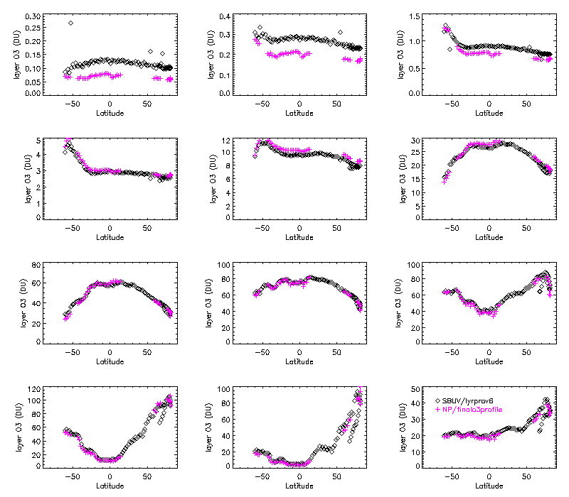
The.
Latitude, Degrees North
From J. Niu, ERT
Notes:
From J. Niu.

Slide 38
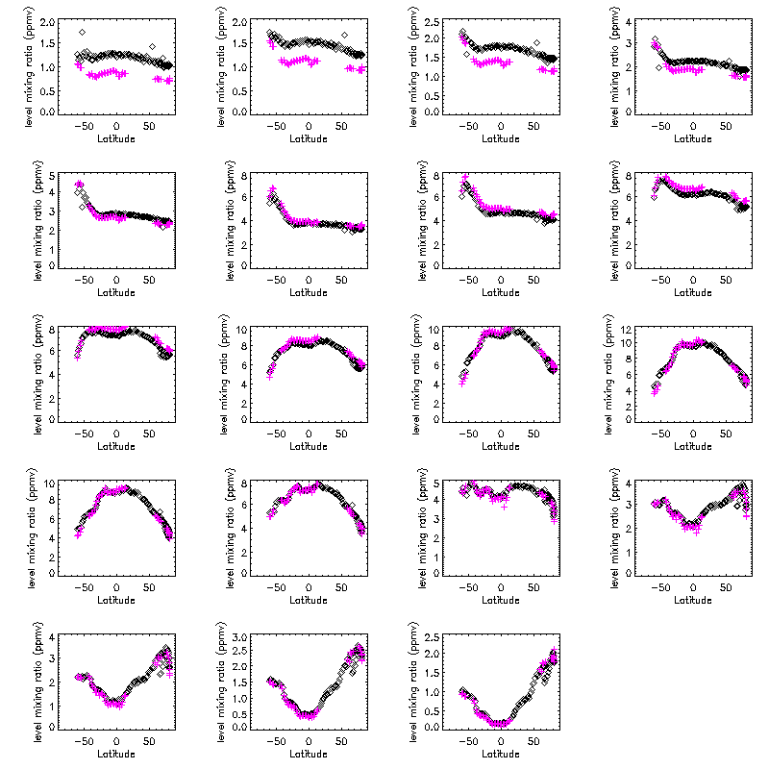
The.
From J. Niu, ERT
Notes:
From J. Niu.

Slide 39
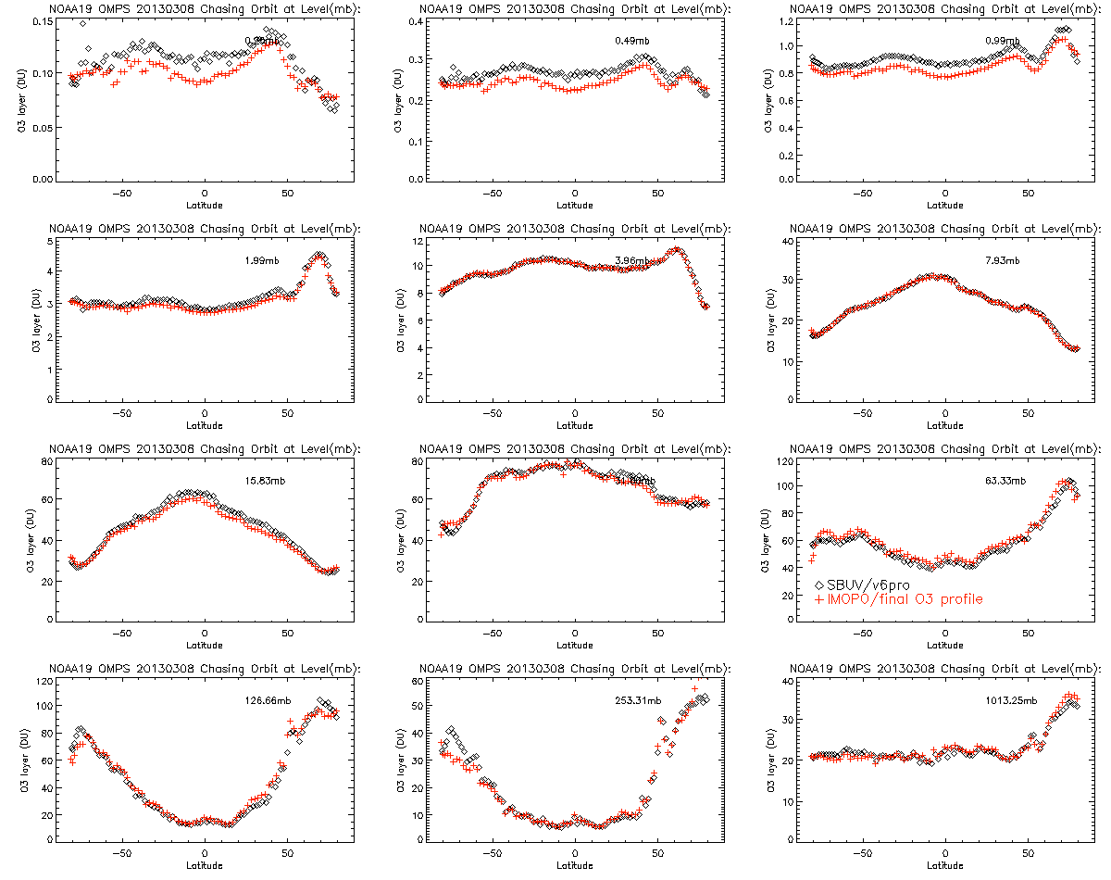
OMPS Nadir Profiler values in Red
NOAA-19 SBUV/2 values in Black
Ozone, Dobson Units
Latitude, Degrees North

Slide 40
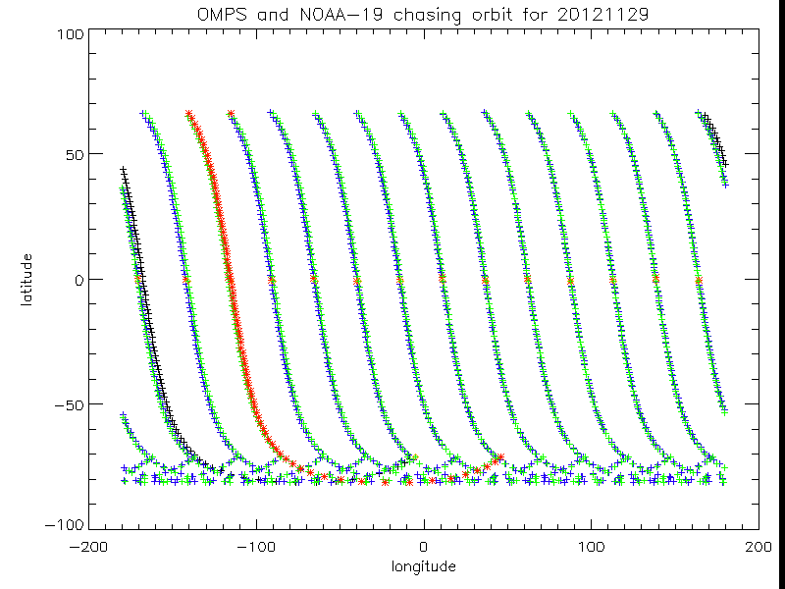
Well-matched Orbits for November 29

Slide 41
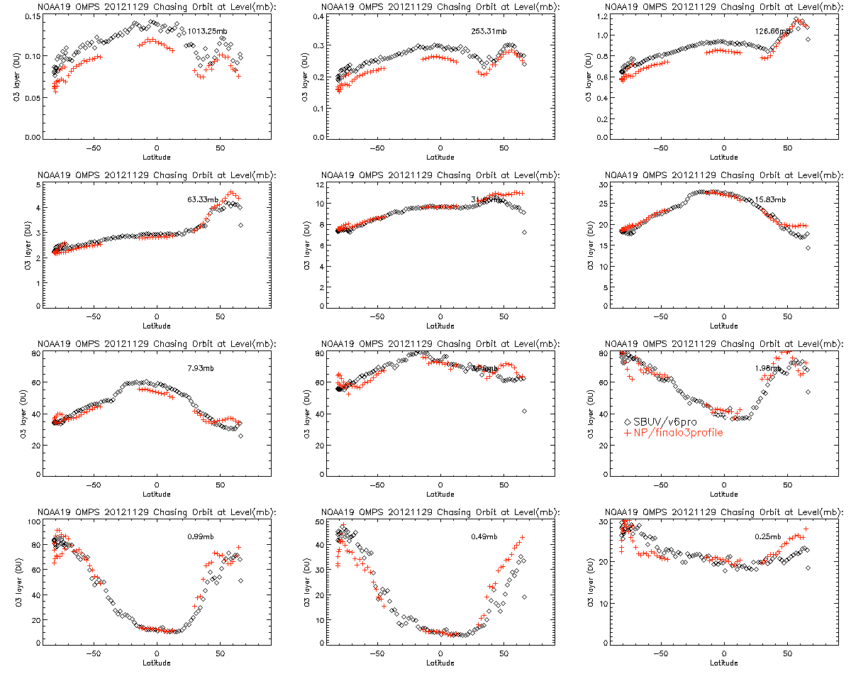
The OMPS Nadir Profiler values are in Red and the SBUV/2 are shown in Black.

Slide 42
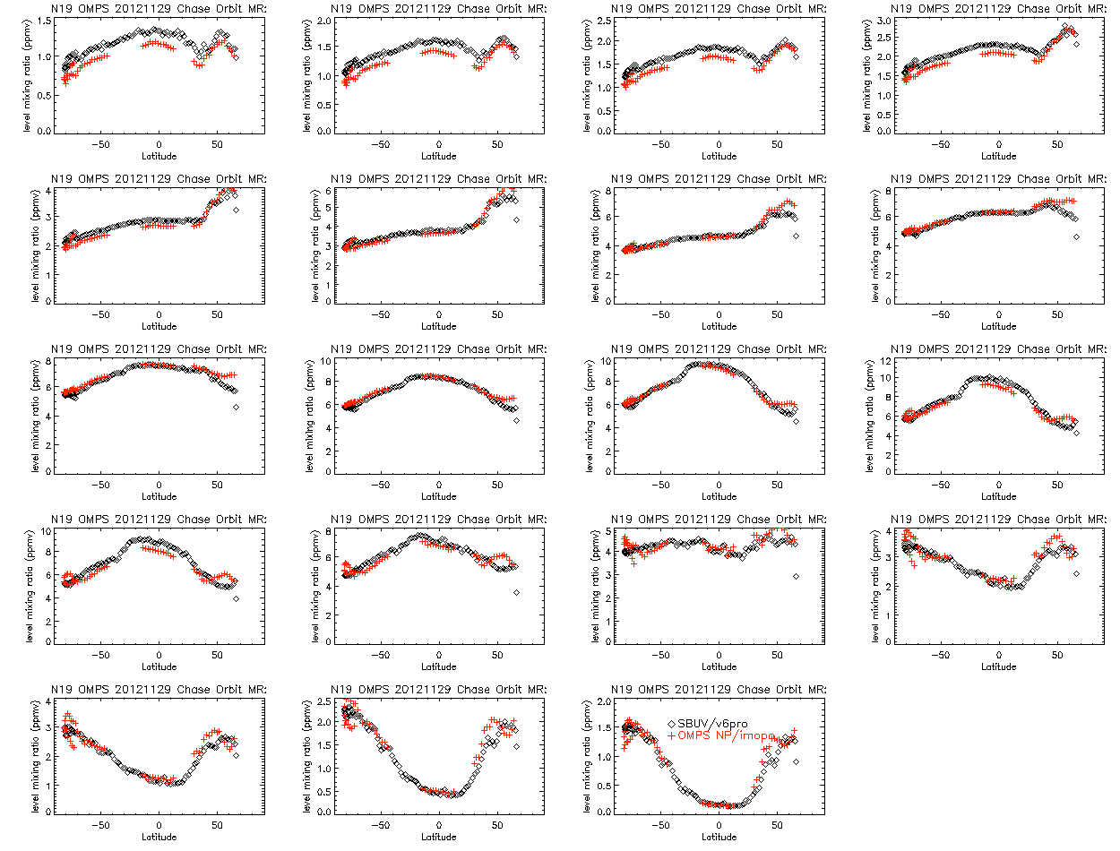

Slide 43
Comparisons between OMPS & MLS
The figures on the next two slides show differences between N-values (-100 * log_10 of top-of-atmosphere albedos) as measured by the OMPS at nadir with those calculated/predicted by using the TOMRAD radiative transfer code with EOS Aura MLS ozone profiles from matchup retrievals and OMPS viewing conditions for solar zenith angles and effective 340 nm reflectivity.
Most of the variations and features can be explained by or are expected from known characteristics of the OMPS SDRs. These include the following:
Offset between NP and NM for 300-310 nm – calibration differences including solar.
Drop off of NM near 300 nm – stray light in the NM as the dichroic cuts off the signal.
Dips down at solar features, e.g., at 280 nm and 285 nm – stray light as additive error for the NP and lower signal at solar lines (Ring effect filling also contributes).
Noise-like features for NP measurements within the SAA – charged particles affect a larger fraction of the measurements as the current data is aggregated over 100 spatial pixels and 38 S.
Slope of differences for non-absorbing wavelengths from 330 to 350 nm – wavelength dependent effects of absorbing aerosols on effective reflectivity.
Study by C. Seftor, NASA/SSAI

Slide 44
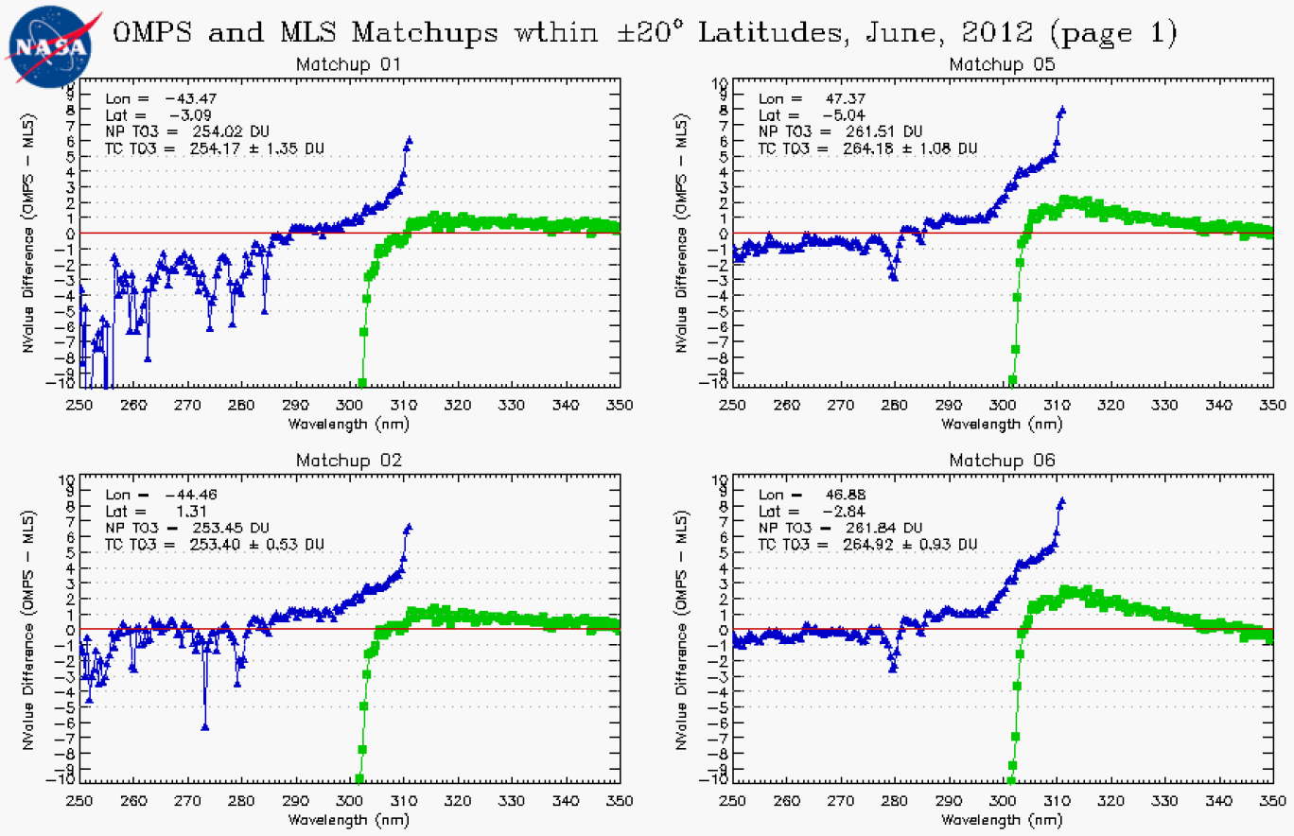
Comparison of radiance/irradiance ratios from OMPS with forward model calculations using EOS Aura Microwave Limb Sounder ozone profile retrievals as input. The Blue points are differences in N-value (1 N-value Unit ~ 2.3%) for the OMPS Nadir Profiler measurements with the MLS predicted values and the Green points are the differences for measurements averaged over the near-Nadir FOVs for the OMPS Nadir Mapper with the MLS predicted values.

Slide 45
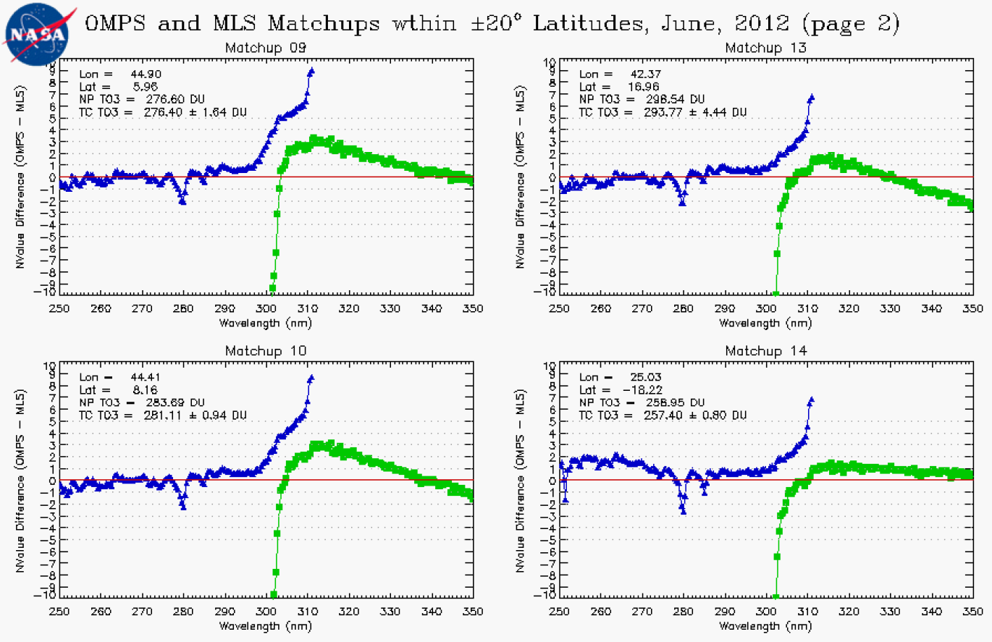
Comparison of radiance/irradiance ratios from OMPS with forward model calculations using EOS Aura Microwave Limb Sounder ozone profile retrievals as input. The Blue points are differences in N-value (1 N-value Unit ~ 2.3%) for the OMPS Nadir Profiler measurements with the MLS predicted values and the Green points are the differences for measurements averaged over the near-Nadir FOVs for the OMPS Nadir Mapper with the MLS predicted values.

Slide 46
IMOPO Known Product Deficiencies
Day One Solar needs a definitive spectrum. (Preliminary update implemented in August 2012 – DR #4797, #CCR 0458^)
  Profile and total ozone error flags are switched in the output. (Parent PCR 27740 – Expected correction mid-2013 in Mx7.0)
Snow/Ice data is all zeroes (DR #4802)
The input-out-of-bound flag (Error Code 20) is set with an incorrect check on surface pressure (DR #4860, CCR 595 implemented Mx6.6 2/28/2013). 20% or more of the data is improperly flagged prior to this.
Stray Light / Radiance Coefficients^
  Correction subroutine and definitive estimates of coefficients are under development (DR #4823). Adjustments could be entered through CF Earth.
Dark Tables weekly updates were begun 2/14/2013 (DRs #4749, #4818)
Wavelength Scale and adjustments^
  Working on definitive Day 1
  Working on adjustments for intra-orbit scale drift
^ These may create large discontinuities in the product performance as they and similar changes enter the system.
Notes:
DR – Discrepancy Report
CCR – Configuration Control Request
Draft Timeline of major changes in OMPS Nadir Products
• Problem with wavelength scale in NM February
• Problem with wavelength scale in NP February (DOY error) Final data at CLASS? No.
• May 7, 2012 – New OMPS NM and OMPS NP Wavelength Scales CCR #389
• June 11, 2012 – New OMPS NM Day 1 Solar Irradiance CCR #411
• July 17, 2012 – OMPS NP Day 1 Solar Irradiance CCR #458
• August 10, 2012 – New NM RT LUT CCR #343 (Mx6.1)
• August 10, 2012 – CTP to UV for INCTO CCR #385 (Mx6.2)
• October 15, 2012 – OMPS NM E/S distance CCR #481 (Mx6.3)
• October 15, 2012 – Partial cloud and VIIRS CF CCR #419 (Mx6.3)
• TLE in use for Ephemeris Mx6.3 – Mx6.4
• Updates to VIIRS Snow/Ice Tiles xxx
Future
• February 2013 – IMOPO Surface Pressure limit too restrictive CCR #595 (Mx6.6)
• April 2013 – CTP for OOTCO CCR #736 (Mx7.0)
• April 2013 – Profile and TOZ flags switched in IMOPO PCR (Mx7.0)

Slide 47
IMOPO Summary of Findings & Recommendations
Promotion to Provisional
  The IMOPO algorithm is functioning correctly. The product precision and accuracy are affected by the current state of the calibration, stray light correction, and wavelength scale. These will continue to change as improved characterizations are brought into the system.
  The OMPS Team recommends that the IMOPO Product be promoted to Provisional Maturity.
Monitoring Figures are available at
http://www.star.nesdis.noaa.gov/icvs/PROD/proOMPSbeta.O3PRO_IMOPO.php
Upgrade to V8TOZ
  The team recommends an upgrade of the current Version 6 ozone profile retrieval algorithm to the V8Pro algorithm in use with the SBUV/2 measurements for both climate data records and operational products. (This is captured in the JPSS system under DR #4256.)

Slide 48
Backup

Slide 49


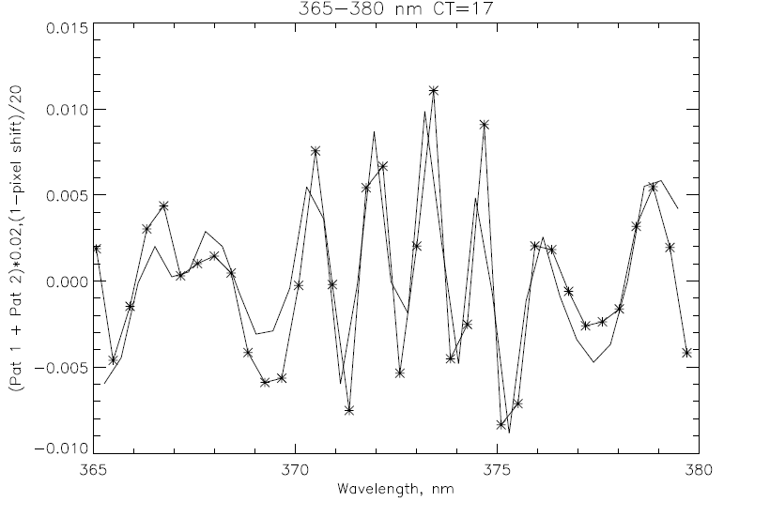
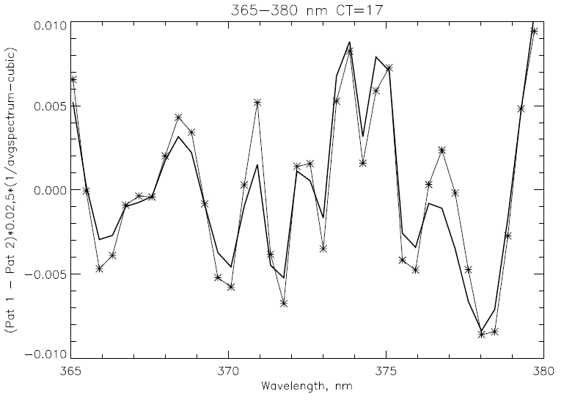
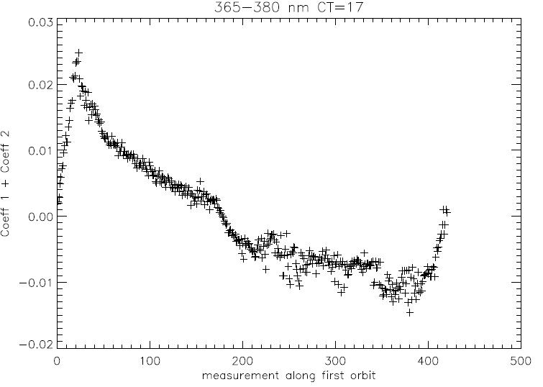







T61: SUOMI National Polar-orbiting Partnership: Ozone Mapping and ProfileR SUite Product Calibration, Validation and Performance
L. Flynn¹, D. Rault², W. Yu³, I. Petropavlovskikh⁴, G. Jaross⁵, Z. Zhang³, J. Niu⁶, C Pan⁷, K. Yang⁸, E. Beach³, X. Wu¹, C. Seftor² , C. Long¹, Y. Hao³
1 NOAA NCWCP College Park MD 20740, 2 SSAI Greenbelt MD 20771, 3 IMSG College Park MD 20740, 4 NOAA ESRL/CIRES Boulder CO 80303, 5 NASA GSFC Greenbelt MD 20771, 6 ERT College Park MD 20740, 7 CICS UMD College Park 20740, 8 AOSC/UMCP College Park 20742
Introduction
Internal Consistency and Measurement Information Content
NOAA, through the Joint Polar Satellite System (JPSS) program, in partnership with National Aeronautical and Space Administration (NASA), launched the Suomi National Polar-orbiting Partnership (S-NPP) satellite, a risk reduction and data continuity mission, on October 28, 2011. The JPSS program is executing the S-NPP Calibration and Validation (Cal/Val) program to ensure the data products comply with the requirements of the sponsoring agencies. The Ozone Mapping and Profiler Suite (OMPS) [1] consists of two telescopes feeding three detectors measuring solar radiance scattered by the Earth's atmosphere and solar irradiance by using diffusers. The measurements are used to generate estimates of total column ozone and vertical ozone profiles. The calibration and validation efforts are progressing well, and both Level 1 (Sensor Data Records/SDRs) and Level 2 (Ozone Environmental Data Records/EDRs) are advancing to release at Provisional Maturity. This poster provides information on the execution of the OMPS Cal/Val Plan with emphasis on the instrument and product performance observed over the first 18 months of the mission. The results of internal consistency analysis techniques and comparisons to other satellite instrument and ground-based products are examined.
The product retrieval algorithms are designed to use ratios of Earth radiance to solar irradiance, to make use of pairs and triplets of measurements, and, in the case of the Limb profiler, to use normalization to measurements at reference tangent heights, greatly reducing sensitivity to instrument throughput changes [3]. The hyperspectral nature of the detectors provides information at wavelengths not used directly in the retrieval algorithm. Residuals for these measurements are used to check the consistency of the retrieved quantities. For example, differences in the ozone absorption cross-section for channels between 306 nm and 313 nm provide a test of the retrievals for equatorial viewing conditions. The differential sensitivity of the top of atmosphere radiances at reflectivity channels from 340 nm to 360 nm to satellite viewing angles and solar zenith angles provide opportunities to check the calibration by comparisons of derived cross track minimum reflectivity estimates. Empirical Orthogonal Function (EOF) analysis was conducted on the covariance matrix for spectra for the central cross-track position for the 365 nm to 380 nm wavelength range for parts of six orbits on 1/28/2012. The first two patterns contain 90% of the variability after removing a 3rd order polynomial from Radiance divided by the Average Radiance. The two patterns are primarily combinations of Wavelength Scale Shift and Ring Effect/Stray Light variations.
Instruments & Measurements
The total column sensor uses a single grating and a Charge-Coupled Device (CCD) array detector to make measurements every 0.42 nm from 300 nm to 380 nm with 1.0-nm resolution. It has a 110° cross-track FOV and 0.27° along-track slit width FOV. The measurements are combined into 35 cross-track bins: 3.35° (50 km) at nadir, and 2.84° at ±55°. The resolution is 50 km along-track at nadir, with a 7.6-second reporting period. (This resolution choice is changeable; we are investigating the use smaller FOVs.) The nadir profile sensor uses a double monochromator and a CCD array detector to make measurements every 0.42 nm from 250 nm to 310 nm with 1.0-nm resolution. It has a 16.6° cross-track FOV, 0.26° along-track slit width. The reporting period is 38 seconds giving it a 250 km x 250 km cell size collocated with the five central total column cells.
The limb profile sensor is a prism spectrometer with spectral coverage from 290 nm to 1000 nm. It has three slits separated by 4.25° with a 19-second reporting period that equates to 125 km along-track motion. The slits have 112 km (1.95°) vertical FOVs equating to 0 to 60 km coverage at the limb, plus offsets for pointing uncertainty, orbital variation, and Earth oblateness. The CCD array detector provides measurements every 1.1 km with 2.1-km vertical resolution. The products for the Limb Profiler are not discussed in detail here.
* EOF pattern
– 0.02-nm shift
* EOF pattern
– ∝ (1/Avg-poly)
Figures (a) and (b) show the sum of the first two EOF patterns (a) and the coefficients (b) for the first orbit. (a) also has the computed variations expected from a 0.02-nm wavelength scale shift. The two curves agree very well. The pattern of the coefficients in (b) may be related to wave-length scale changes produced by intra-orbital variations in the optical bench temperatures. While the shifts are small, we plan to implement a correction/adjustment to improve the ozone products. Figure (c) shows the differences of the first two EOF patterns. Now the additional curve is a scaled reciprocal of the average spectrum pattern. Again, the two curves agree very well. One would expect this pattern to be produced by inelastic scattering (Ring Effect) or out-of-band stray light. The figure on the Bottom Right tests this by looking at the dependence of the coefficients (y-axis) with the 375 nm radiances (x-axis). The inverse relationship between the two suggest that the major source of these variations is the Ring Effect – not Stray Light. The OMPS NPP Science Team has plans to exploit this signal to create UV cloud optical centroid estimates. Given the radiance levels, a 0.01 pattern in values in figures (a) and (c) equates to approximately a 1% radiance variations.
(a)
0.5%
0.5%
(c)
Nadir
Profiler
Solar Irradiance
Solar Line
Main
Electronics
(b)
(d)
Limb
Profiler
Diffuser
Earth Radiance
Entrance Aperture
Entrance Aperture
Wavelength, nm
Instrument Fields of View. Schematic from Ball Aerospace and Technology Corporation.
Earth
Ozone Absorption Features
Δ
Sun
Radiance/Irradiance Ratio
Calibration System
Each instrument has two solar diffusers; a working and a reference.
Typical spectra from 310 to 380 nm for OMPS Nadir Mapper.
The OMPS instruments (Nadir Mapper, Nadir Profiler, and Limb Profiler) are designed to take a set of measurements to allow analysts to maintain the instrument characterization and calibration.[2] For each of the instruments, this task can be broken into two components, tracking the performance of the CCD array detectors and electronics, and tracking the performance of the optical components, that is, the telescopes and spectrometers. The instruments make measurements on the night side of orbits with the apertures closed. One set is made without any sources and is used to track the CCD array dark currents. Another set is made with illumination by an LED and is used to track CCD non-linearity and pixel-to-pixel non-uniform response. The instruments also make solar measurements using pairs of diffusers. Judicious operation of working and reference diffusers allows analysts to track the diffuser degradation. The solar measurements also provide check on the wave-length scale and bandpass. The instruments have completed multiple passes through their internal dark and nonlinearity calibration sequences and have made an annual set of solar measurements. The instruments show little degradation in the comparisons of the working & reference diffuser measurements over the first year.
Ozone Amount, DU
The figure above displays the results of an off-line processing of OMPS Nadir Mapper data to show its capability for monitoring atmospheric SO₂. The false color image captures an SO₂ plume originating from Mount Copahue (Δ Location of SO₂ Source) as it moves out into the South Atlantic off the coast of South America. (Processed by the NASA OMPS NPP Science Team.)
Latitude, Degrees North
← Effective Reflectivity
for the March 23, 2013 for the OMPS Nadir Mapper measurements. The quantity represents the UV reflectivity of the clouds and surface in each Field-of-View. This image shows the expected range of values over the globe with bright clouds and polar ice and dark open ocean.
The figures above have comparisons of the ozone profile retrievals between the OMPS Nadir Mapper operational (Currently Version 6) ozone profiles and the NOAA-19 SBUV/2 processed with the Version 6 ozone profile retrieval algorithm. The data are from a single pair of orbits on March 8, 2013 where the two satellites are flying in formation (orbital tracks within 50 KM and sensing times with 10 minutes). The ozone profile retrievals are reported in Dobson units for 12 pressure layers. They are plotted here versus Latitude. The 12 Umkehr layers boundaries are at: [0.0,0.25,0.50,0.99,1.98,3.96,7.92,15.8,31.7,63.3,127.0,253.0,1013] hPa.
The top three layers’ results are in the top row with the topmost layer on the upper left. The lowest layer’s results are in the figure on the bottom right. The OMPS Nadir Profiler values are in Red/Orange and the SBUV/2 are shown in Black. The figures show general agreement between the retrievals for the two instruments but with the OMPS NP retrieving smaller values at the top of the profiles. This is probably due to inaccuracies in the initial calibration of the shorter wavelength channels but could also be symptomatic of stray light.
Aerosol Index from the operational algorithm in IDPS for March 23, 2013.. This quantity is derived from residuals at a longer reflectivity channel relative to a shorter channel. The range of values is as expected but there are significant cross-track biases.
Aerosol Index→
Total Ozone
from the operational multiple triplet retrieval algorithm in IDPS for March 23, 2013. The values show some cross-track variations and are offset approximately 2% from some other satellite ozone product. These uncertainty levels are consistent with the independent calibration parameters and tables currently in use in the operational system.
Provided by R. Evans NOAA/ESRL
Comparison of daily mean total column ozone estimates from NPP OMPS Green and the Dobson Instrument in Boulder Colorado. The OOTCO are weighted averages of overpass data near the station location. They had been running approximately 4% low but this difference has been reduced after changes in the algorithm cloud pressure data and adjustments for Sun/Earth Distance in the last six months.
Rapid Comparison to Other Products
The ozone products from the OMPS Nadir Profiler are compared to similar products from the operational Solar Backscatter Ultraviolet instruments (SBUV/2) and ground-based Dobson and Brewer instruments operated in the Umkehr mode. Comparisons of the OMPS NP zonal means of ozone profiles and initial measurement residuals with the currently monitored set of results for the SBUV/2 instruments on NOAA-16, -17 -18, and -19 are taking place. Of particular interest are those computed for instruments in similar orbits (NOAA-19 and NOAA-18 SBUV/2s) at all latitudes and for those computed for NOAA-17 SBUV/2 in a morning orbit for no-local-time difference latitudes. (If one examines a pair of ascending and descending polar-orbiting satellites, they will find two latitudes where the nadir views are at the same local time of day for both. One on the day side and the other 180 degrees away on the night side with a 12-hour difference in local time.) For the OMPS Nadir Mapper, we are making comparisons of its global ozone, effective reflectivity and aerosol products to similar ones from the Ozone Monitoring Instrument (OMI) and to the Global Ozone Monitoring Experiment (GOME-2). Sets of overpass match up values for the satellite instruments with ground-based locations have been expanded to include OMPS products.
The figures above compare the OMPS Nadir Profiler and Limb Profiler data for September 6, 2012. The Limb data has been smoothed vertically to be similar to the Nadir resolution. Refinement of both products is continuing. (Limb Profiler data were processed by the NASA OMPS NPP Science Team.)
References
Current Products are Provisional
[1] Juan V. Rodriguez, et al., “An overview of the nadir sensor and algorithms for the NPOESS ozone mapping and profiler suite (OMPS),” Proc. SPIE, 4891, April 2003,.
[2] Quinn P. Remund, et al., “The ozone mapping and profiler suite (OMPS): on-orbit calibration design,” Proc. SPIE, 5652, pp.165-173. December 2004,.
[3] Earth Science Satellite Remote Sensing Vol.1: Science and Instruments, Qu, J.J.; Gao, W.; Kafatos, M.; Murphy, R.E.; Salomonson, V.V. (Eds.), 2006, Springer Verlag,. “Chapter 21: Introduction to the Ozone Mapping and Profiler Suite (OMPS),” L. Flynn, C. Seftor, J. Larsen, and P. Xu, Springer Verlag, July 2004.
Satellite Monitoring http://www.star.nesdis.noaa.gov/icvs/PROD/proComparison.php
OMPS NM and NP Data archive http://www.nsof.class.noaa.gov/saa/products/search?datatype_family=OMPS
Operational BUFR ozone products http://projects.osd.noaa.gov/NDE/index.htm
Ground-based http://www.esrl.noaa.gov/gmd/grad/neubrew/ProductDisplays.jsp
Related talks & posters at the NSC
Session 2.0 POES/JPSS
Poster T-52 On the Provisional S-NPP Ozone Mapping and Profiler Suite SDR
Poster T-60 Ozone Instrument Calibration and EDR Products Validation with STAR ICVS
Poster W-85 Operational Ozone Products Available from NOAA/NESDIS
This work was support by NOAA, NASA, the JPSS Program, and the NDCD Science Data Stewardship Program.
Opinions expressed are those of the authors & do not imply any official positions of NOAA or the JPSS Program
OMPS data are at provisional maturity levels; General research community is encouraged to participate in the QA and validation of the product, but need to be aware that product validation and QA are ongoing.
The OMPS SDR and EDR data sets are available to the public at http://www.nsof.class.noaa.gov .

Slide 50












Implementation of the Version 8 Total Ozone and Ozone Profile Algorithms
with the Ozone Mapping and Profiler Suite (OMPS) to Continue Ozone Climate Data Records
D. Swales^{1,4}, Z.-H. Zhang¹, L. Flynn², E. Beach¹, W. Yu³3, J. Niu³, Y. Hao¹
1 I.M. Systems Group Rockville MD 20852; 2 NOAA NESDIS 5200 Auth Rd. Camp Springs MD 20746; 3 Earth Resource Technology Laurel MD 20707; 4 Currently with CIRES, Boulder CO 80305
Introduction
Algorithm Adaptation
NOAA, through the Joint Polar Satellite System (JPSS) program, is advancing its polar-orbiting satellite system with new instruments for weather forecast and climate monitoring. The first satellite, the Suomi Nation Polar-orbiting Partnership satellite (S-NPP), was launched on October 28, 2011 [in partnership with National Aeronautical Space Administration (NASA)]. See http://npp.gsfc.nasa.gov/ for information on the payload compliment of other instruments. The Ozone Mapping and Profiler Suite (OMPS) onboard the S-NPP satellite (and future JPSS satellites) is the next generation of US operational space-borne UV and ozone monitoring instruments.
The suite consists of two telescopes feeding three detectors measuring solar radiance scattered by the Earth's atmosphere and solar irradiance by using diffusers. The measurements are used to generate estimates of total column ozone and vertical ozone profiles.[1,2] NOAA and NASA are working to continue the Satellite BUV Climate Data Records for Total Column Ozone and Ozone Profiles with the measurements from these new instruments. The total ozone (V8TOZ) and vertical ozone profile (V8PRO) climate data records (CDRs) are long-term datasets that have been derived by applying the Version 8 retrieval algorithms[3] to measurements obtained over the last 33 years from several UV spectrometers onboard various satellites. The V8TOZ CDR is derived from measurements obtained by the SBUV, SBUV/2, TOMS, and OMI instruments. The V8PRO CDR is derived from data obtained by the SBUV and SBUV/2 instruments. The OMPS Nadir Profiler (OMPS NP) replaces the NOAA Solar Backscatter Ultraviolet (SBUV/2) series of instruments as a source of measurements for the profile CDR and the OMPS Nadir Mapper (OMPS NM) replaces the SBUV/2 and TOMS series.
The OMPS consists of three spectrometers; two nadir viewing and one limb viewing, however only the products from the nadir instruments will be discussed here. (See related presentation at this meeting on the OMPS Limb Profiler: in 4D Ozone vertical profile measurements with the OMPS Limb Profiler, in 3Ea Initial assessment of OMPS sensor performance, and in 3Ea Data from the OMPS Limb Profiler: How and when it will be available, etc.)
The OMPS NM (total column ozone sensor) uses a single grating and a CCD array detector to make measurements every 0.42 nm from 300 nm to 380 nm with 1.0-nm resolution. It has a 110° cross-track FOV and 0.27° along-track slit width FOV. The measurements are combined into 35 cross-track FOVs: 3.35° (50 km) at nadir, and 2.84° at ±55°. The resolution is 50 km along-track at nadir, with a 7.6-second reporting/aggregation period.
The OMPS NP (nadir ozone profile sensor) uses a double monochromator and a CCD array detector to make measurements every 0.42 nm from 250 nm to 310 nm with 1.0-nm resolution. It has a 16.6° cross-track FOV, 0.26° along-track slit width. The reporting period is 38 seconds giving it a 250 km x 250 km cell size collocated with the five central Nadir Mapper cells.
To properly adapt the V8PRO and V8TOZ algorithms to be used with measurements obtained from the OMPS instrument, new radiative transfer look-up-tables (RT LUTs) had to be created by using monochromatic radiance forward model results and the OMPS instrument slit functions. The Ring effect was incorporated into the monochromatic radiance prior to the convolution with the OMPS slit functions. To account for the effects of a spectral smile in the OMPS NM data, RT LUT results are generated over a range around each channel’s target wavelength. The RT LUT’s entries are interpolated within the retrieval algorithm to construct a table at the proper wavelength center. The 12 channels for the V8TOZ have nominal band centers at: [308.7,310.8.311.9,312.6,313.2,314.4,317.6,322.4,331.3,345.4,360.2,372.8] nm. This RT LUT interpolation scheme also allows for the correction of any identified intra-orbital shifts or long-term drift in the wavelength scale.
For the V8PRO, the OMPS NP slit function was implemented into the retrieval algorithm for single-scattering calculations at the shorter wavelengths; λ < 287nm. The 12 channels currently used in the V8PRO have band centers at: [252,273,283,288,292,298,302,306,313,318,331,340] nm. The eight shortest channels are taken from the OMPS NP and the four longer channels are taken from the OMPS NM (aggregated to match the OMPS NP 250X250 KM^2 FOV).
← The OMPS NM has an asymmetrical spectral smile across the 110° FOV that increases with magnitude at longer wavelengths. The smile magnitude varies from 0.19-0.27nm to the left and 0.22-0.36nm to the right of nadir. The longest wavelength is observed approximately at cross-track position 16.
Cross-track View Position
Smile Magnitude, nm
Illustration of wavelength choices for OMPS NM →
The stars represent the actual wavelength band centers as measured on the OMPS NM CCD-array. The horizontal lines give the band centers used in the instrument RT LUT nodes for this channel. The spectrally adjacent (-0.42 nm) row in the CCD-array is also shown below the target row.
Wavelength, nm
Diffuser
Calibration System and Soft Calibration
Entrance Aperture
The OMPS instruments (Nadir Mapper, Nadir Profiler, and Limb Profiler) are designed to take a set of measurements to allow analysts to maintain the instrument characterization and calibration.[4] For each of the instruments, this task can be broken into two components, tracking the performance of the CCD array detectors and electronics, and tracking the performance of the optical components, that is, the telescopes and spectrometers. The OMPS also has multiple diffusers, one working and one reference, which allows for tracking long-term solar measurement degradation to produce a stable calibration critical for climate monitoring applications. The instrument makes additional measurements to track dark current, linearity, detector gain, and wavelength scale. These are augmented by soft calibration and internal consistency checks.
Channel Number
Cross-track View Position
Entrance Aperture
A set of corrections to adjust the Solar irradiance spectra to match the Earth radiance spectra is computed by the following method. For each of the 196 wavelengths and each of the 35 cross-track pixel aggregations, a high-spectral resolution reference solar spectra is convolved with the OMPS bandpasses for a discrete set of band centers placed from -0.06 to +0.06 nm about the nominal Earth-view band center. The changes in the solar irradiance for wavelength scale shift is well approximated by a quadratic in this shift quantity as shown in the figure above. The green dots represent the computed shifted proxy solar irradiances relative to the unshifted value. The solid line represents the quadratic fit to these differences to use as a correction. A 196X35X3 matrix of the quadratic coefficients is read into the program and used to calculate adjustments to the solar irradiance for the wavelength scale differences with the Earth radiance scales.
Earth
Sun
Change/Adjustment
Instrument Fields of View. Schematic from Ball Aerospace &Technology Corporation.
Each instrument has two solar diffusers; a working and a reference.
Black Week 1
Blue Week 2
Green Week 3
Red Week 4
Noise and Stray Light for OMPS NP Radiances
Wavelength Shift, nm
Comparisons to Contemporaneous Record Components
Estimates of noise in the OMPS NP measurements. The Root-Mean-Squared Residuals (RMSRs in % of the average signal) estimates on the right were computed by using Empirical Orthogonal Function analysis of the covariance matrix for clean data for 230 spectra. A spectral screen detected and removed one deviant value on average from each of the 120-wavelength spectra. The removal of the second EOF pattern was somewhat arbitrary as it and the third EOF may be stray light patterns. The covariance computation used a 6th order polynomial for normalization.
While the OMPS is a new suite of instruments, we are fortunate that its ozone records will overlap with those from other instruments contributing to the ozone CDRs. For the total ozone products, we can make extensive comparisons with zonal means and the full daily maps from other satellite products. We will also compare each individual component of the record to ground-based assets, e.g., the Dobson Network. An example with SBUV/2 total ozone is given below.
Reflectivity, %
↓
RMSR, %
For the ozone profile products will make zonal mean comparisons. We will also use chasing orbit comparisons – orbits with nadir tracks closely matched in space and time. An example pair of orbits is given in the figure to the right. We will also use no-local-time-difference latitude comparisons – If one examines a pair of ascending and descending polar-orbiting satellites, e.g., S-NPP and NOAA-17, they will find two latitudes where the nadir views are at the same local time of day for both. One is on the day side and the other 180° away on the night side with a 12-hour difference in local time. This allows comparisons with similar viewing conditions and avoids complications from diurnal effects.
The NOAA-19 POES is in a similar orbit as the S-NPP spacecraft (sun-synchronous polar orbit with close to 1:30 PM local time ascending node equator crossing). Approximately every 12 days the two satellites’ orbits align very well in both space and time. This figure shows the measurements locations for a pair of orbits on May 16, 2012 the asterisks are S-NPP OMPS NP FOV locations and the diamonds are NOAA-19 SBUV/2 FOV locations. Given the large fields-of-view of the two instruments, these matchup orbits provide a good source of comparisons.
|Lat|<20
Lon<-100
Cross-track View Position
Wavelength, nm
Latitude, Degrees North
OMPS Minimum Reflectivity Cross-Track Dependence.
The lines in the figure show the weekly, one-percentile effective reflectivity values for the four weeks in the month of June for all the data in a latitude/longitude box in the Equatorial Pacific versus cross-track view position. (17 is the nadir position and 0 and 34 are the extreme viewing angles.) We expect the one-percentile effective reflectivity values to be approximately 4% for this region of the globe from climatological measurements made by other instruments. The different values and the cross-track dependence observed here are due to inaccuracies in the initial solar spectra and radiance calibration. While each pixel in an OMPS CCD array can be considered as an independent instrument, reproducible internal comparisons such as this one allow us to track their relative calibration very accurately.
The scatter plot on the left compares simple three-wavelength Mg II core-to-wing ratio variations (radiance at 280 nm divided by the average of 277 nm and 282 nm) with longer wavelength variations at 305 nm. There is no geophysical reason to expect the two to be correlated, and the exposed relationship is symptomatic of out-of-band stray light. The core average is ~0.4 of wings, so this -0.5% to 1.5% variation represents (1.0/0.4 – 1 =) 1.5 times the expected stray light variations in the wings. This means that the 283 nm channel used in the retrieval will need to have a correction applied.
Mg II Index Variation, %
Longitude, Degrees East
305 nm Variation, %
Time series of initial V8PRO residuals for OMPS NP February through June
Comparisons of OMPS Total Ozone Retrievals with those from EOS Aura OMI and EuMetSat MetOp-A GOME-2. Data for all three maps are processed with the Version 8 algorithm. (OMI is processed by the NASA EOS Aura Science Team.) There is general agreement between the three products but the OMPS requires additional work before it will be of Climate Data Record quality. For example, the “scalloping” in the Equatorial region is produced by inaccuracies in the cross-track calibration.
References
[1] Juan V. Rodriguez, et al., “An overview of the nadir sensor and algorithms for the NPOESS ozone mapping and profiler suite (OMPS),” Proc. SPIE, 4891, April 2003, DOI: 10.1117/12.467525.
[2] Earth Science Satellite Remote Sensing Vol.1: Science and Instruments, Qu, J.J, et al. (Eds.), 2006, Springer Verlag, ISBN: 978-3-540-35606-6. “Chapter 21: Introduction to the Ozone Mapping and Profiler Suite (OMPS),” L. Flynn, C. Seftor, J. Larsen, and P. Xu, Springer Verlag, July 2004.
[3] Solar Backscatter Ultraviolet Instrument (SBUV/2) Version 8 Ozone Retrieval Algorithm Theoretical Basis Document (V8 ATBD), Edited by L. Flynn (Last Revision February 2, 2007) www.star.nesdis.noaa.gov/smcd/spb/calibration/icvs/sbuv/doc/SBUV2_V8_ATBD_020207.pdf
[4] Quinn P. Remund, et al., “The ozone mapping and profiler suite (OMPS): on-orbit calibration design,” Proc. SPIE, 5652, pp.165-173. December 2004.
Related talks and posters at the QOS 2012:
3Ea Verification and early Operations for the Ozone Mapping and Profiler Suite (OMPS)
4C The Use of OMPS Nadir Data to Extend Long-term Ozone Climate Records
NOAA Satellite Ozone Product Monitoring:
http://www.star.nesdis.noaa.gov/icvs/PROD/proOMPSbeta.TOZ_V8.php
http://www.ospo.noaa.gov/Products/atmosphere/
Opinions expressed are those of the authors and do not imply any official positions of NOAA or the JPSS Program.
Work was support by NOAA, NASA, the JPSS Program, and the NDCD Science Data Stewardship Program.
OMPS data used in figures are at Beta maturity level – minimal validation with changes expected and not ready for use in scientific studies.
Initial Measurement Residuals for the OMPS NP Version 8 Profile Product: The nine figures show the initial residuals for profile wavelengths [252, 274, 283, 288, 292, 298, 302, 306 and 313 nm, (a) to (i), respectively] for the V8PRO product from S-NPP OMPS compared to the same product for the operational NOAA-18 and NOAA-19 SBUV/2 for the equatorial daily zonal means (20N to 20S) with 0-90W removed to avoid South Atlantic Anomaly effects. The residuals are in N-values (1 N unit ~ 2.3%). The time period is the first six months of this year (February to June for OMPS). Notice that the residuals for OMPS, have maintained a persistent bias relative to the SBUV/2 residuals. This processing uses a fixed day one solar spectrum only adjusted for Earth/Sun distance . This will be refined in the future to use the Mg II Solar Index and response scale factors to adjust for changes in solar activity.

Slide 51
Additional Information on OMPS
Near term work on the total ozone products includes:
  Evaluation of reflectivity and aerosol index products
  Evaluation of cross track consistency
  Modeling of along orbit wavelength scale variations
Daily Maps of the OMPS INCTO and V8TOZ are available to Science Team Members at
http://www.star.nesdis.noaa.gov/smcd/spb/icvs/proComparison.php
Near term work on the ozone profile products includes:
  Comparison of profiles and initial residuals to SBUV/2
  Modeling of stray light for the Nadir Profiler channels
Information on IMOPO and V8PRO will be made available soon at
http://www.star.nesdis.noaa.gov/smcd/spb/icvs/proSBUV2operational.php

